Slide 1
Sexual Health Services
Webinar for Parents and Carers
Solent NHS Trust
Presented by Claire Wells & Gordon Atkins February 2024
Notes:
Introduction- CW

Slide 2
Welcome
Welcome to the webinar for ‘Parents and Carers’. We really appreciate you taking the time to be with us this evening.
Being an important person in anyone's life can sometimes be challenging, we are here as equals to support, help, signpost and learn from you.
Our aim is to help make Relationships and Sex Education(RSE) an easier topic to discuss with your young people.
Notes:
CW

Slide 3
Housekeeping
Please keep microphones on mute.
If you have any questions, please put them in the chat box,
and we will answer them at the end.
Please keep any questions anonymous to protect confidentiality.
This webinar will be recorded and posted online but no participation included.
Attendees will be able to access a copy of the presentation slides from our website.
Notes:
CW You may have a question which could be answered further along in the presentation.
We will be using polls at the beginning, middle and end of the webinar. If they come up for you please can you fill them in as they help us to have evidence for future webinars.

Slide 4
@solentnhstrustsexualhealthservices
@LetsTalkHants
@LetsTalkHants
Notes:
CW Social media presence. Follow us

Slide 5
Topics for Today
Who we are and what we do.
Contraception and Sexually Transmitted Infections (STI’s)
Safeguarding and confidentiality.
Young people's rights.
How you can support your young person with their sexual health, relationships and wellbeing.
Services available to young people, including online services
Where to access services.
Q&A.
Notes:
CW In this webinar we will be discussing:
Who we are and what we do as a Sexual Health Service supporting young people.
What does safeguarding and confidentiality look like when accessing sexual health services.
Understanding young people's sexual health rights.
What services are available to young people including contraception and STI screening.
Online services including Personal Health Record (PHR)
How we support young people including discussions around positive relationships, sexuality and gender and the impact of social media.
How we can support you to support your young person with their relationships, sexual health and wellbeing.
Young people aren’t always getting the right sex education which then influences how they perceive and talk about sex amongst their peers.

Slide 6
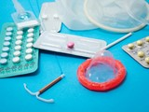
Sexual Health is an Important Part of Life
It can have an impact on all aspects of health, including physical, mental health, emotional and social wellbeing. Keeping safe, being informed and respectful are important factors for everyone regardless of gender, sexuality, ethnicity, religion, disability and age.
Notes:
CW Pictures have links

Slide 7
Sexual Health is an Important Part of Life
Having effective and inclusive sexual health support means people are:
More likely to report sexual abuse/harassment.
More likely to experience sex which is consensual.
More likely to have non-regretted and positive choices about sexual activity.
More likely to use contraception and condoms.
Less likely to have an unplanned pregnancy or sexually transmitted infection.
There is no evidence to suggest that it will encourage your child to become sexually active.
sex education forum
Notes:
CW

Slide 8
Relationships and Sex Education, the Facts
When they have received good RSE, young people are:
• More likely to seek help or speak out.
• More likely to practice safer sex and have improved health outcomes.
• More likely to have consented to first sex, and for first sex to happen at an older age.
• More likely to have an understanding, of digital safety, in regard to relationships and sex.
• More knowledgeable and aware of discrimination, gender equity and sexual rights.
• Less likely to be a victim or perpetrator of sexual violence.
Relationships and Sex Education: The Evidence | sexeducationforum.org.uk
Notes:
GA Research from the Sex Ed Forum

Slide 9
Talking to Young People about Sexual Health
It is important for young people to be able to have a safe and open conversation with a trusted adult about their relationships, sexual health and wellbeing.
Discussion offers protective factors against early sexual activity. This allows young people time to think about things like :
‘Who can I talk to?’
‘ Am I ready to have sex?’
‘Is this relationship right for me’
‘Is this really what I want at this time?’
Notes:
GA

Slide 10
Sexual Health Services
Sexual Health Promotion – Practitioners, Communications and Networking
Sexual Health Clinics – clinic finder to find nearest clinic to you
British Pregnancy Advisory Service (BPAS) – Pregnancy Options
Condom/GIO Scheme – Get it on card for condoms
Online services – Personal Health Record (PHR), Condoms/ STI kits by post
www.letstalkaboutit.nhs.uk
Notes:
GA These are services we offer click on them for links. We will talk more about each section later in presentation.

Slide 11
Confidential Access to Services
By offering confidential services, young people are more likely to ask for help and are therefore at less risk of having unhealthy relationships and regretted sexual experiences.
Initial conversations in clinic are one to one, to ensure Confidentiality, and Safeguarding. This is discussed at every appointment, and a risk assessment completed (for under 18s and vulnerable adults.)
We always encourage and support young people to reach out and have these conversations with the important people in their lives.
Notes:
GA

Slide 12
Protecting Young People
The following risk assessments are used by practitioners when deciding if a young person is competent to make decisions, about things that affect them.
Practitioners must establish that the following criteria are met.
Safeguarding – Risk Assessments/CERAF (Child Exploitation Risk Assessment Framework).
Fraser Guidelines – 1985
The young person understands the advice and is mature enough to understand the implications.​
The practitioner cannot persuade the young person to inform his or her parents.
The young person is likely to have sex with or without contraceptives.
The young person’s health is likely to suffer if they do not receive contraceptive advice or treatment.
It is in the young person’s best interest to receive contraceptive advice or treatment without parental consent.​
Gillick Competencies – (Refers to a legal case from the 1980’s which looked at whether Doctors should be able to give contraceptive advice or treatment to under 16’s, without parental consent)
Gillick competency applies mainly to medical advice but is often used in a wider context to help assess whether a child has the maturity to make their own decisions and to understand the implications of those decisions. Age, maturity and mental capacity is considered. This is being known as Gillick Competent.
Notes:
GA Safeguarding link is to Hampshire County Council.
Gillick case was overturned

Slide 13
Young People’s Rights Within Sexual Health Services
A young person aged 13 to 16, has the same rights to confidentiality as an adult.
The young person will be encouraged to discuss their visit to Sexual Health Services with parents/carers/guardians.
The health care professional does not have to inform parents/carers or guardians, or anyone else, after completing the risk assessment, as long as they believe that the young person is Fraser competent. This means they fully understand the information and decisions involved, and that they are not at risk of harm.
The only time a professional might have to tell someone else is if they believe there is a safety or welfare risk to the young person or other persons involved according to the law and safeguarding guidelines. They will discuss this disclosure and what needs to happen with the young person.
The situation is different for young people under 13, the law states that people of this age cannot consent (say yes) to any sexual activity. A safeguarding referral will automatically be raised.
Notes:
GA

Slide 14
The Law Protects not Prosecutes
Notes:
GA

Slide 15
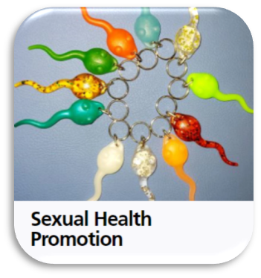
Solent Sexual Health Promotion Practitioner Services
A team of practitioners across Hampshire & the Isle of Wight aim to reduce teenage pregnancy/ unplanned pregnancy and STI rates (promoting testing)
Practitioners work individually with people who are having unprotected sex & people who are not using contraception
We accept in-service referrals and referrals from a range of external agencies for 1:1 sessions
Practitioners support GP’s, Pharmacies, schools and Youth Services to offer free condom provision, ‘Get It On Scheme’ and pregnancy testing
Practitioners accept referrals for clients who are sexually active or with the indication to be sexually active soon with the risk of STIs & teenage pregnancy
Practitioners run training for schools and professionals working with young people
:
Notes:
CW
More information can be found at https://www.letstalkaboutit.nhs.uk/contraception/get-it-on-condom-card/

Slide 16
Young people can access the following services for Free
Clinics at various venues where specialist sexual health nurses are present.
STI - testing, advice and support.
Contraception – Choices and advice
Online services – Information, Personal Health Record (PHR), Condoms and STI kits by post
Condoms - including the
Get it On card
Condoms | Lets Talk About It
Notes:
CW

Slide 17
Personal Health Record (PHR)
Help the Young Person to register for an online PHR account.
Order free condoms by post to your home
Personal Health Record
Order Free STI kits to your home
Young People (U16) will get a phone call from us when ordering.
Notes:
CW

Slide 18
Sexually Transmitted Infections (STIs)
STIs can be passed on through any sexual activity
Our aim is to :
Educate Young People about STIs, increasing knowledge to protect themselves and their partners and promote healthier choices
Promote condom use to reduce transmission
Promote testing for STIs
Make tests more accessible (order online tests)
Notes:
Talk around STI
Transmission prevention and testing
Any sexual activity
Increase knowledge is power to make healthier choices
If screened and infection early identification , treatment can be given Undectable = Untransmissable (U= U)

Slide 19
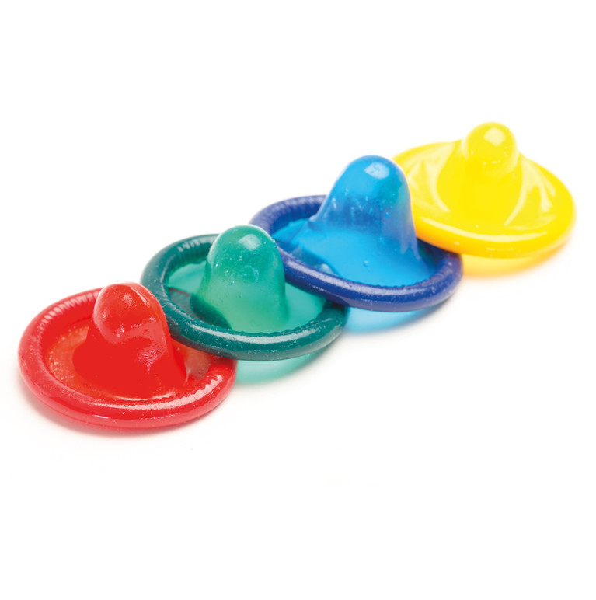
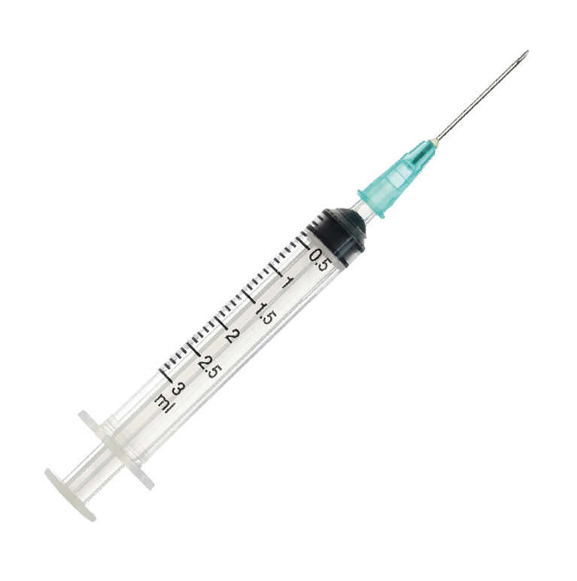
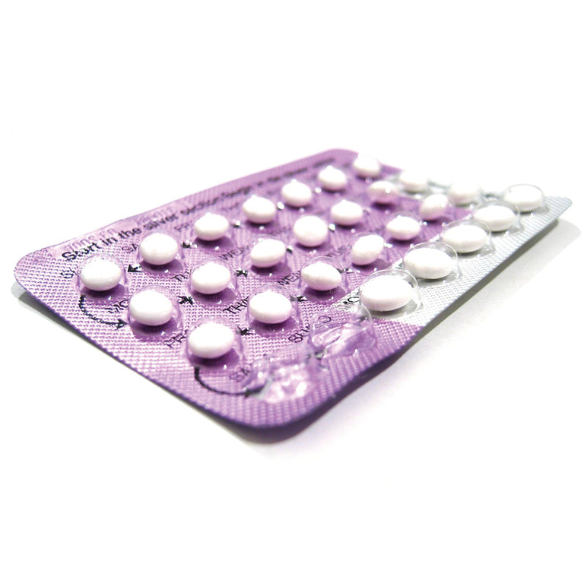
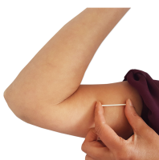
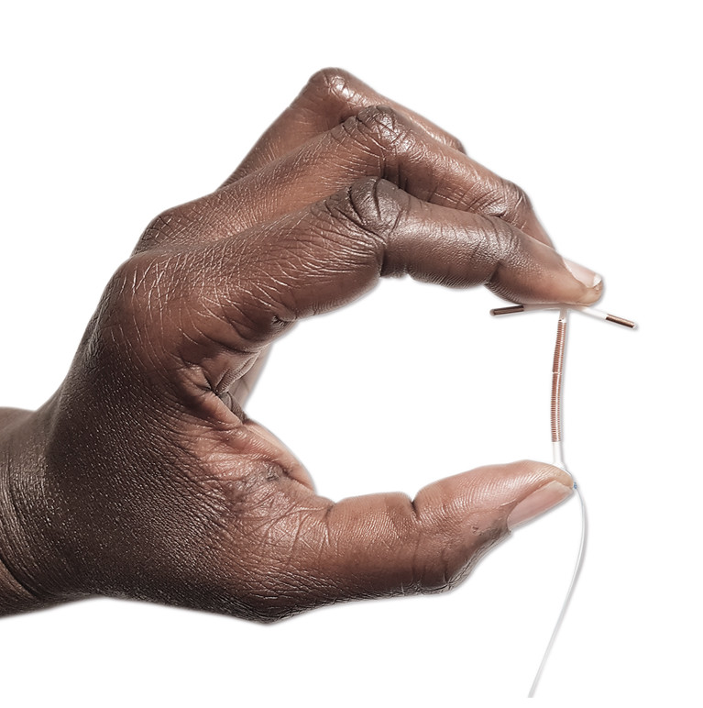
Contraception
Prevents pregnancy by interfering with the normal process of ovulation, fertilisation, and implantation.
NHS contraception choices
condoms
The Patch
The Injection
The Pill
The Ring
The Coil
The Implant
Notes:
CW
Click on link gives you quiz to find out three best options for the individual
Hormonal and non hormonal

Slide 20
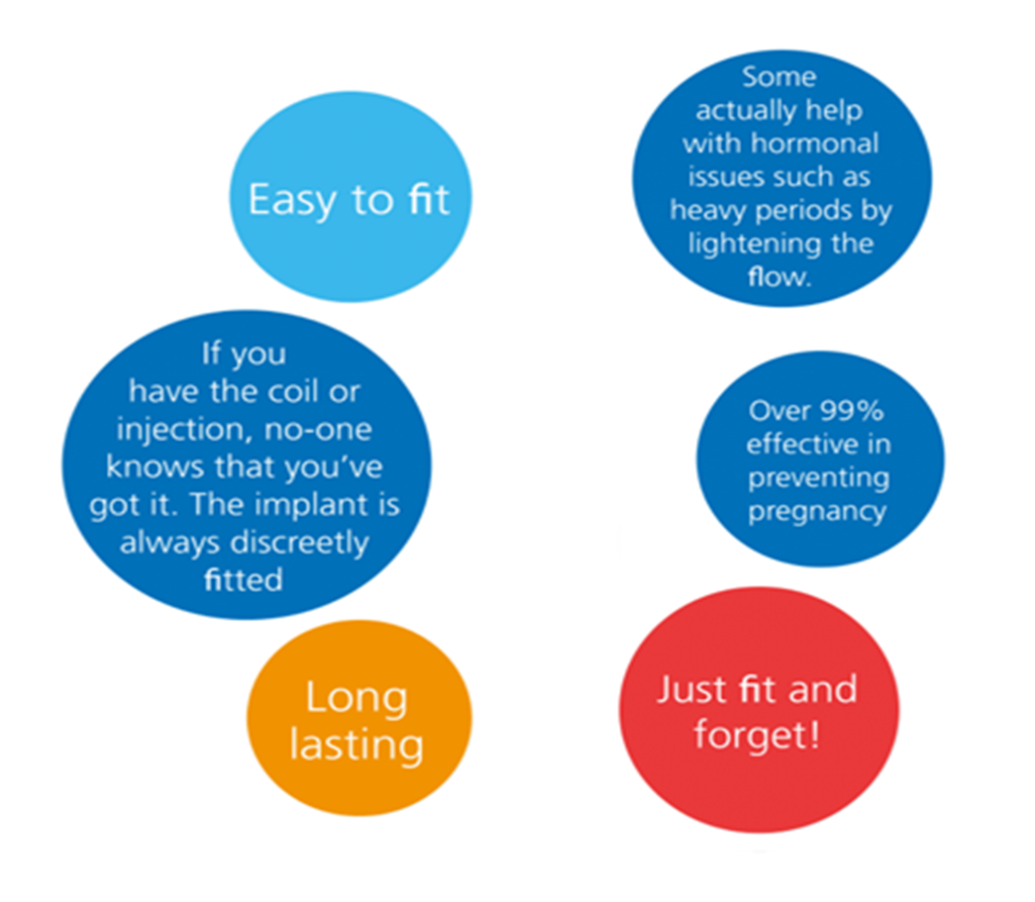
Fit & Forget Contraception also known as
LARC
(Long-acting reversible contraception)
Notes:
CW

Slide 21
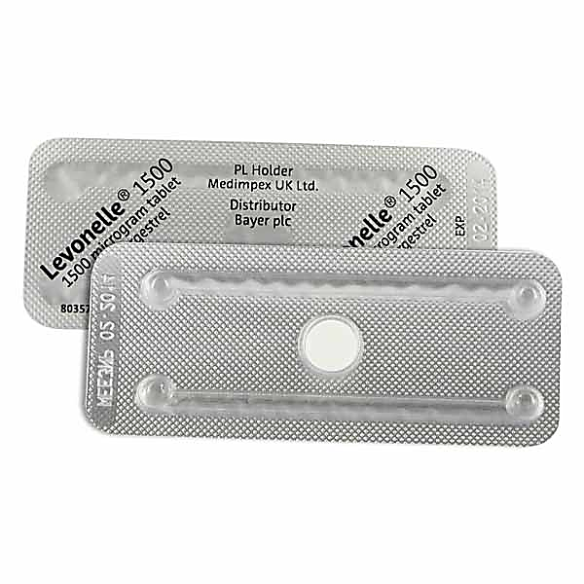
Emergency Contraception FREE For All Young Women (Including Under 16’s)
Can be used up to 3 days or 5 days after unprotected sex.
Get as soon as possible.
Available from :
Sexual Health Clinics
GP Surgeries
A & E
Walk-In Treatment Centres
Most Pharmacies (some charge or don’t prescribe for under 16s)
72-hour pill
(Morning after pill/plan B)
Copper Coil
The ‘Ella One’ pill & the Coil can be obtained up to 5 days after,
from Sexual Health Services
Notes:
CW
Phone ahead to pharmacy

Slide 22
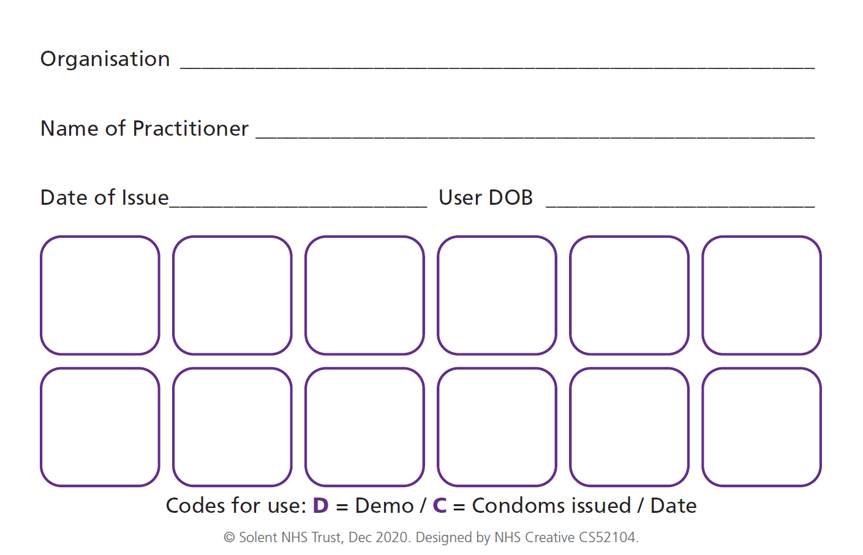
Get It On Card (GIO) Scheme
Get It On Condom Card is also known as the C-Card (Condom card)
Get it On (GIO) is the condom distribution scheme running across Hampshire, Isle of Wight, Portsmouth and Southampton.
Anyone under 25 you can get free condoms from lots of different organisations. Under 16 years olds can still join the scheme.
GIO
A GIO Condom-Card (C-Card) is a 2-sided wallet sized card that looks like this:
Notes:
GA
More information can be found at https://www.letstalkaboutit.nhs.uk/contraception/get-it-on-condom-card/

Slide 23
Pregnancy Options
Pregnancy testing if a young person thinks they are pregnant.
Free in clinics and other trained venues.
Not accurate until three weeks after last time they had unprotected sex.
Speak with them and support them with their pregnancy options.
Going ahead with the pregnancy and keeping the baby.
Going ahead with the pregnancy and considering adoption.
Sexual Health services will signpost them to their GP and or midwife.
Terminating the pregnancy, also known as an abortion.
Sexual Health services will support them with making an appointment with BPAS.
Pregnancy worries
BPAS 03457 30 40 30
Notes:
GA

Slide 24
How Can You Support Young People with Relationships, Sexual Health and Wellbeing?
Encourage conversation – Having a safe space to talk openly with your young person is a great place to start. Talking about sex can be a very sensitive subject, not just for our young people, but also for us. Consider how it makes you feel too. Not all of us feel confident or comfortable talking about these subjects. Let your child know they can always speak to you or with another trusted adult.
Embarrassment/Stigma – Normalise conversations around relationships and sex. The more you do it, the easier it gets. Try to be as open and factual as you can to make the whole conversation run smoother. Reassure them that although talking about sex and relationships can be embarrassing, emotional, confusing and sometimes upsetting, you are there to listen and not judge.
Most of all, where possible, try to keep these chats fun, laughter is a great way to eliminate awkwardness.
Notes:
GA

Slide 25
How Can You Support Young People with Relationships, Sexual Health and Wellbeing?
Relationships, Sex Education (RSE) – Be inquisitive about the RSE your child gets. Does it include essential topics like: Puberty, Consent, Contraception, STIs, Healthy Relationships, Online Safety, Self Esteem.
Learn and research together - Ask about things that they have seen/heard and don’t understand. Suggest it could be a learning curve for you both…Research something together to make sure they’re well informed and have the correct information. Most teenagers have probably learnt a lot about relationships and sex already (both consciously and sub-consciously) Lets Talk About It website
Guard against misinformation - Young people often have a misinformed view on sexual health due to where they get their information eg: Peers, TV, Social media, Tik Tok, and porn. With supportive conversations you can help educate against this.
Notes:
GA

Slide 26
How Can You Support Young People with Relationships, Sexual Health and Wellbeing?
Get information and support for you and your young person - Reach out to your young person’s school, other supportive organisations and your local sexual health services.
Enable access to services – If they are sexually active or starting to think about the next step, encourage them to come into clinic so they can discuss safer sex. Support them by coming into the sexual health clinic with them.
Talking about Porn- Porn is often brought into a young person’s life indirectly. Young people are not necessarily ‘seeking’ out porn themselves, but statistics show that they see graphic sexual images at very young ages. Talk about this with them, it helps create a realistic picture of sex and sex within a healthy relationship.
Notes:
GA Young people are curious

Slide 27
Porn and the Law
It isn’t illegal for children and young people under the age of 18 to watch porn.
It is illegal to show anyone under the age of 16 porn or give them access to it.
The law is there to protect not prosecute
Young People learning about sex and relationships from porn can lead to:
Unrealistic attitudes about sex and consent.
More negative attitudes about roles and identities in relationships.
Unrealistic expectations of body image and performance.
Learn About Porn (Without Having To Watch It) - BISH (bishuk.com)
Report Remove | Childline
Notes:
GA It’s illegal for anyone under 18 to share explicit images or films of themselves or another young person, even if it was shared with their permission. Only the police can decide whether or not to charge a young person with a crime. It’s a good idea to speak to them if you’re worried. It’s important to understand the law around porn and sending/receiving nude images It’s illegal for anyone under 18 to share explicit images or films of themselves or another young person, even if it was shared with their permission.

Slide 28
Sending Nudes and the Law
The Law is there to protect children from abuse.
Sharing nudes is when someone sends a naked or semi-naked image or video to another person. The term ‘sexting’, is often used by young people to talk about sharing sexual messages and not imagery.
The law says that creating or sharing sexual images or videos of a child under18 is illegal, even if the person creating or sharing the image is a child. This includes:
sending sexual messages to a child
a child taking an explicit photo or video of themselves or a friend
sharing an explicit image or video of a child, even if it's shared between children of the same age
having, downloading or storing an explicit image or video of a child, even if the child gave their permission
for it to be taken.
sharing an explicit image or video of a child is illegal, even if it's shared between children of the same age.
‘Sharenting’ - or adults sharing a photo of a child to raise awareness is also illegal.
Sending nudes NSPCC remove nude images NSPCC talking about nudes
​
Notes:
GA
Sharing nudes is when someone sends a naked or semi-naked image or video to another person. The term ‘sexting’, is often used by young people to talk about sharing sexual messages and not imagery.
The Law is there to protect children from abuse. If an incident involving a young person sharing a nude is reported to the police, it is very unlikely it will result in the child being prosecuted.

Slide 29
Foundations of a Healthy Relationship
Communication
Respect
Trust
Honesty
Supportive
Feeling safe
Space to have own interests & friends
Consent
Notes:
Important in relationships as parent carer, if YP have this support easier to talk about emotions, relationships & sex

Slide 30
Support for Young People
Young Persons Information
There are a range of useful groups and organisations that offer great services for young people across Southampton, Hampshire, Isle of Wight and Portsmouth
Notes:
CW

Slide 31
Support for Young People around Sexuality LGBTQ+
LGBTQ+ is an acronym that stands for Lesbian, Gay, Bisexual, Trans, Questioning, Plus
Young People may find it difficult to talk about their sexuality and our service can help them alongside other specialist organisations, that support the LGBTQ+ community
Sexuality is diverse, and there are many different types. It can take time to figure out the sexuality that the individual feels fits them best. Sexuality can change over time.
Embracing your own sexuality can be a very liberating, exciting and positive experience.
Sexuality is an important part of ourselves. There is no right or wrong, it’s about what’s right for the individual.
Some people have a hard time accepting others who are different to themselves, this can lead to discrimination
Sexual Health Services - lesbian, gay, bisexual, trans
Love has no labels
Notes:
Gordon/Anna

Slide 32
Sexual Health Promotion Team
Community and Networking Lead
Laura Davies
Communications and Engagement Development Manager
Katie Temple - solentsexualhealthpromotion@solent.nhs.uk
Basingstoke, Farnborough, Aldershot & Alton
Natalie D’Anna-Brown
Andover, Eastleigh, Winchester
Vicky Rodd
Southampton & New Forest
Flower Kate
Isle of Wight
Anna Murray
Portsmouth, Fareham & Gosport
Gordon Atkins
Petersfield, Liss, Bordon, Havant & Alton
Claire Wells
Notes:
CW

Slide 33
Useful links to other Services
LGBTQ+
LGBTQ lets talk about it
pregnancy worries lets talk about it
SARC - sexual assault referral centre
Sexual Health & Wellbeing - Brook
NSPCC | The UK children's charity | NSPCC
Barnardo's (barnardos.org.uk)
CEOP Education (thinkuknow.co.uk)
British Pregnancy Advisory Service (BPAS)
Treetops Sexual Assault Referral Centre
(SARC)
Brook Advisory Service
NSPCC
BARNARDOS
CEOPS The National Crime Agency's CEOP Education team aim to help protect children and young people from online child sexual abuse.
Notes:
CW

Slide 34
Thank You for Your Time Any Questions ?
@solentnhstrustsexualhealthservices
@LetsTalkHants
@LetsTalkHants
Linkedin Sexual Health Services link
Notes:
CW

