Slide 1
Sexual Health Services Hampshire & Isle of Wight HIV Webinar
Notes:
Introductions
Name, role, pronouns

Slide 2
HIV specialist team
Specialist HIV Nurses
Pharmacists
Consultants
HIV Coordinators
Health Advisors
Peer Supports
Nurse Therapist/Mental Health Nurse
Dieticians
Joint Rheumatology Clinic
Joint Hepatology Clinic
Joint Haemophilia Clinic

Slide 3
What is your understanding of HIV & AIDS?
Undetectable?
Death sentence?
There is no cure?
Outdated?
Gay-only disease?
Sharing needles drugs/tattooing?
No symptoms?
Prep?
Stigma?
Manageable?
You get AIDS from sex?
Starts with a cold?
Not talked about much these days?
Not easily transmitted?
Can’t have children?
Causes the immune system to become extremely weak?
1980/90s
It’s in the blood?
Notes:
Take a moment to think about what you know about HIV. Don’t worry if you feel this is outdated information. Today we will be letting you know the facts around HIV today.
We asked at registration if people were willing to anonymously share any points of understanding they had around HIV. Some of these are shown on screen

Slide 4
History
It’s a Sin
La!
Channel 4, (2021), It’s a Sin
https://www.channel4.com/4viewers/blog/its-a-sin
Notes:
Most-binged new series ever.
Set between 1981-1991 in London during the AIDS crisis.
Lots of discussion about HIV – increase in testing.
What was show in It’s a Sin was very much ‘then’ and things are so so different today.

Slide 5
History
AIDS Monolith – Don’t Die of Ignorance
UK Government, (1987), AIDS Monolith https://www.nationalarchives.gov.uk/films/1979to2006/filmpage_aids.htm
Notes:
The AIDS monolith is one of the most recognisable images in the history of HIV In the UK. It most likely will have been something you remembered when we asked you to think about what you knew.
For some people, this advert from 1987 may be the last piece of information they had on HIV/AIDS. Therefore, their knowledge is very outdated.
First advice to UK medical practitioners published in 1985, but HIV had been circulating since early 80s.
Advert made people feel to ‘disconnect’ – You have to look for HIV information.

Slide 6
HIV & AIDS
H I V
Human
Immunodeficiency
Virus
A I D S
Acquired
Immune
Deficiency
Syndrome
AIDS cannot be transmitted between people. HIV can.
You cannot be given a diagnosis of AIDS unless you are HIV positive.
Notes:
HIV was named in 1986, before then was discovered and named as HTLV-III and LAV.
Human Immunodeficiency Virus (HIV) is a virus that attacks cells that help the body fight infection.
There is no cure, but it is treatable with medicine.
'Gay-Related Immune Deficiency' (GRID) – 1981 in USA
Renamed AIDS in 1982 after found in heterosexuals and Haitians "the 4H disease", as it seemed to single out homosexuals, heroin users, hemophiliacs, and Haitians
Acquired Immune Deficiency Syndrome (AIDS) is a collection of illnesses and infections which happen when your immune system has been damaged by HIV.

Slide 7
HIV & AIDS - Terminology
AIDS?
Late-stage HIV infection.
HIV Positive?
Living with HIV.
Died of AIDS?
Died from AIDS related illness.
Notes:
Why we don’t hear or use the term ‘AIDS’ as much
Thanks to HIV treatment, not many people in the UK develop illnesses related to HIV. The term ‘late-stage HIV infection’ is more commonly used.
Those who are diagnosed with late-stage HIV infection can start treatment which enables their immune system to repair a lot of the damage the virus has done.
Defined by a series of conditions.
Saying HIV positive is very clinical – Someone who has HIV is living with a manageable condition. Emphasis on Living .
AIDS doesn’t directly cause death, but the illnesses associated with it which are a result of weakened immune system.

Slide 8
How HIV is transmitted
Semen
Vaginal fluids, including menstrual blood
Anal secretions
Breast milk
Blood
Mother to baby (vertical transmission)
Unprotected sex
Sharing sex toys
Fisting
Sharing injecting equipment

Slide 9
How HIV Symptoms Present
Acute HIV infection & Seroconversion
Asymptomatic
Symptomatic
Late-Stage HIV Infection
https://www.tht.org.uk/hiv-and-sexual-health/about-hiv/symptoms-hiv
https://www.aidsmap.com/about-hiv/stages-hiv-infection
Notes:
Initially symptoms can be mild - flu like symptoms, night sweats, not everyone will experience seroconversion symptoms. This is when the body is reacting to the presence of HIV and attempting an immune response
During this time they are very infectious as high levels of virus in body.
After this, HIV can cause no complications for a long time – years. However, if untreated and HIV continues to weaken the immune system, the body is susceptible to other illness:
Symptoms can be vague, tiredness , diarrhoea, weight loss skin problems, candidiasis, cervical cancer, reduced immune system, opportunistic infections, HIV might not always be considered.
Can be missed if GP /DR does not do a sexual health history !, AIDS defining illness should trigger a HIV test by GP or Dr. We have devised a resource for GPs to advise of these symptoms, we will discuss this at the end.

Slide 10
Who can get HIV?
ANYONE
Notes:
Any age – Less numbers for younger, but still affects them.
<15: 20
15-24: 395
People may think they are not at risk of HIV, certain sectors of the population do not screen regularly for HIV - bisexual men & women – trans women & men.

Slide 11
Who is living with HIV?
?
Estimated that 1 in 16 people living with HIV in the UK are unaware they have it.
https://www.nat.org.uk/about-hiv/hiv-statistics
Notes:
Importance of testing

Slide 12
How is HIV Transmitted?
Most people get HIV from someone who doesn’t know they have it.
WINDOW
PERIOD
https://i-base.info/guides/testing/viral-load
https://i-base.info/guides/testing/tables-diagrams-and-illustrations
Notes:
Remember we discussed that shortly after acquiring HIV, people have high levels of HIV in their body? This is called ‘viral load’. The higher the viral load, the higher the risk of HIV transmission.
If they are unaware of this infection, they may very easily pass HIV on to others via the routes we already discussed.
In regards to testing, someone may acquire HIV between regular testing, or not have been tested in a while.
Tests also have ‘window periods’ the time between acquiring an infection, and being able to detect it in a test. So if testing too soon after an exposure risk, may have a negative result. We will look at window periods more when we discuss testing.

Slide 13
How is HIV Transmitted?
2019
https://www.nat.org.uk/about-hiv/hiv-statistics
Public Health England, (2020) Trends in HIV testing, new diagnoses and people receiving HIV-related care in the United Kingdom: data to the end of December 2019 Health Protection Report Volume 14 Number 20 3
Notes:
New diagnoses in 2019 in UK – routes of transmission.
Note low Injecting drug use, and low mother to baby.
Some populations are disproportionately affected.

Slide 14
Who is living with HIV?
MSM
41% gay or bisexual men
Public Health England, (2020) Trends in HIV testing, new diagnoses and people receiving HIV-related care in the United Kingdom: data to the end of December 2019 Health Protection Report Volume 14 Number 20 3
Notes:
Have sex with each other – but, anal sex higher risk.
Of the 4,139 people diagnosed with HIV in the UK in 2019, 41% were gay or bisexual men.
Not every MSM identifies as gay or bisexual, reference to 46% on last slide.
Targeting, might not be targeted by traditional methods and missed out by testing
Will discuss stigma later

Slide 15
Who is living with HIV?
37% black African men and women
Public Health England, (2020) Trends in HIV testing, new diagnoses and people receiving HIV-related care in the United Kingdom: data to the end of December 2019 Health Protection Report Volume 14 Number 20 3
Notes:
Of the 1,559 heterosexual people diagnosed with HIV in 2019, 37% were black African men and women. despite making up less than 2 per cent of the British population.
Approximately half of Black African men and women diagnosed with HIV in the UK are thought to have acquired HIV while living in the UK.
BISH – groups have sex with groups

Slide 16
Late Diagnosis
42% diagnosed late
52% diagnosed late
59% diagnosed late
35% diagnosed late
Public Health England, (2020) Trends in HIV testing, new diagnoses and people receiving HIV-related care in the United Kingdom: data to the end of December 2019 Health Protection Report Volume 14 Number 20 3
Notes:
Of those diagnosed with HIV in 2019, 42% were diagnosed late. Of those diagnosed with HIV, 52% of heterosexual men were diagnosed late; 59% of people aged 65 and older; and only 35% of gay and bisexual men were diagnosed late.
The UK surveillance definition of a late HIV diagnosis is a reported CD4 count <350 cells/mm³ within 91 days of diagnosis. People diagnosed late with HIV are estimated to have been unaware of their infection for at least three to five years, increasing the likelihood of ill-health and premature death as well as onward transmission.
Testing inequalities?

Slide 17
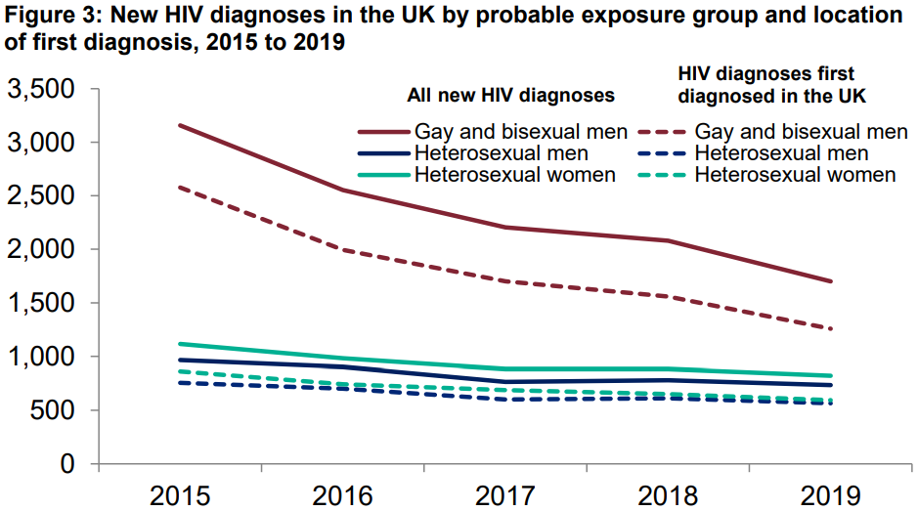
New HIV cases are falling
Public Health England, (2020), Trends in HIV testing, new diagnoses and people receiving HIV-related care in the United Kingdom: data to the end of December 2019. Health Protection Report Volume 14 Number 20
Notes:
In 2019 there were 4,139 HIV diagnoses; a 10% fall from 4,580 in 2018 and a fall of 34% from a peak of 6,312 new diagnoses reported in 2014.
The decline in new HIV diagnoses in recent years is largely driven by a steep fall in diagnoses among gay and bisexual men (GBM) from a peak of 3,214 in 2014 and 2,079 in 2018 to 1,700 diagnosed in 2019 (a 47% and 18% drop respectively). This is due to a combination of prevention methods which we will talk about later
Diagnoses in women however only declined by 4% in the past year. Women account for 28% of new diagnoses in 2019. So whilst making up a large proportion of new diagnosis, the numbers have not dropped as significantly.

Slide 18
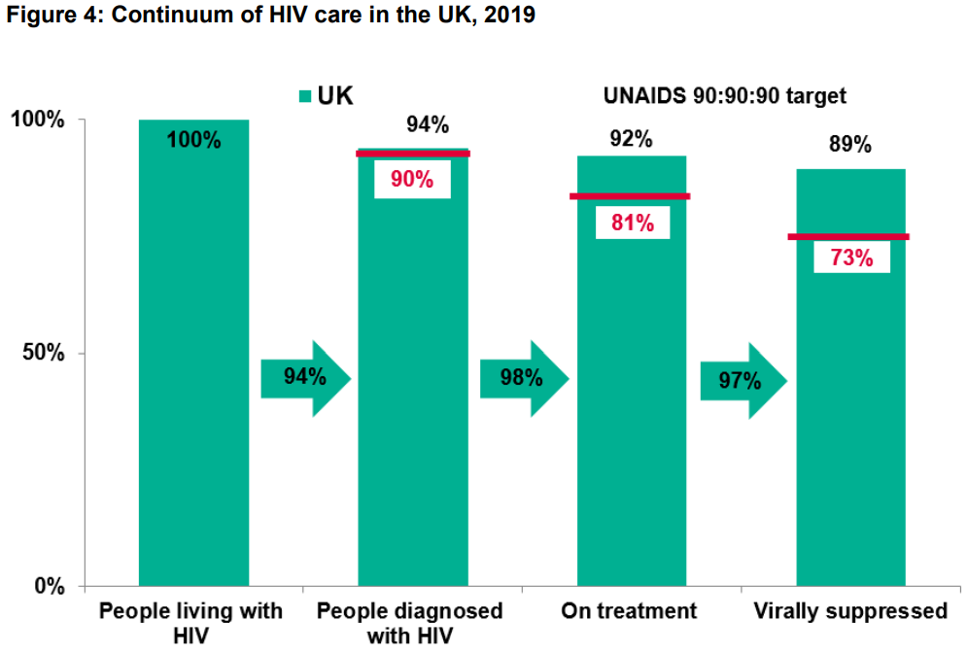
90-90-90
90% living with HIV diagnosed
Of these, 90% on treatment
And of these, 90% virally suppressed
Public Health England, (2020), Trends in HIV testing, new diagnoses and people receiving HIV-related care in the United Kingdom: data to the end of December 2019. Health Protection Report Volume 14 Number 20
https://www.nat.org.uk/about-hiv/hiv-statistics
Notes:
In the UK we are exceeding this for the third year in a row.
In London, we are exceeding 95-98-97 – Meeting the London 2030 target of 95-95-95 for second year in a row.
We will cover treatment and ‘viral suppression’ shortly.
4th 90 – 90% experiencing a ‘good quality of life’

Slide 19
HIV Locally
Areas of HIV High Prevalence
Diagnosed HIV prevalence of between 2 and 5 per 1,000 people aged 15 to 59 years.
Portsmouth City - Southampton City - Rushmoor
GP
Registering
Blood Test
https://fingertips.phe.org.uk
https://www.nice.org.uk/guidance/ng60/chapter/recommendations
Notes:
Recommendations: Young people and adults in areas of high HIV prevalence are offered an HIV test by their GP practice when registering or when having a blood test if they have not had an HIV test in the past 12 months.
For those of you who like data, you can view these indicators in the sexual health section of fingertips.

Slide 20
HIV Commission
End new HIV transmissions in England by 2030​.
https://www.youtube.com/watch?v=YC9QqaRbPFc
https://www.hivcommission.org.uk/
Notes:
Launched December 2020.
HIV commission set about to look at offering testing in more places
Read the full report.
RSE in schools and normalising HIV comes from education early o

Slide 21
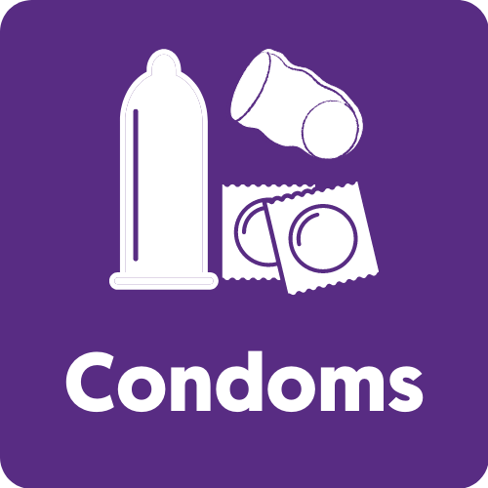
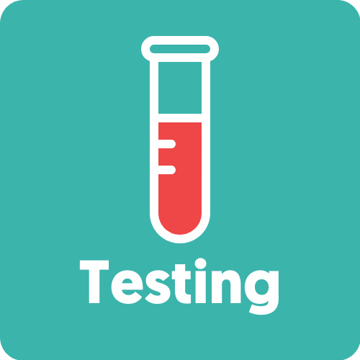
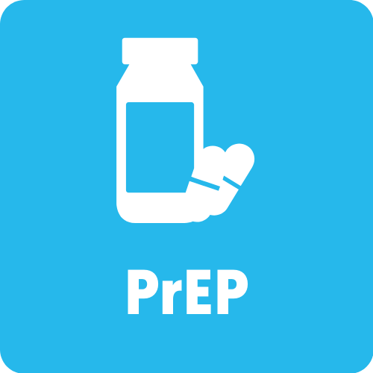
HIV Prevention

Slide 22
Around
Effective
https://www.who.int/hiv/topics/condoms/en
Notes:
Male (external) latex condoms have an 80% or greater protective effect against the sexual transmission of HIV and other STIs.
However, they need to be used correctly and consistently.

Slide 23
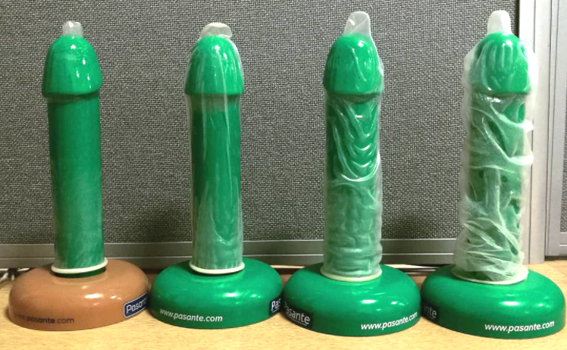
www.startswithme.org.uk/condom-fitter
Notes:
Big ones, small ones, thin ones thick ones, flavoured ones, textured ones, glowing ones, shaped ones
External (male)
Internal (female/femidom)
Non-latex
Some people say that thicker or ‘extra safe’ condoms should be used for anal sex. However, it has been proven that they are no safer than regular condoms in this instance. But if someone is more likely to use a condom if they feel it is safer by being thicker, then absolutely no reason to stop them!
Check the date! And look for British Kite Mark or CE mark
Water or silicone based lube – oil will break. Video on IG

Slide 24
Why might someone not use condoms?
Notes:
“But they smell” “Oh they are slimy” “They don’t make them big enough” “tricky to put on” “kills the mood” “Too tight” “can’t feel anything” or very simply “I just don’t like using them”
Some find condoms tricky to use and can kill the moment – practice alone makes perfect. Find the best size. Posh wanks
Some don’t like the feeling of them, but you can get thinner condoms, or textured ones to heighten sensation
Internal condoms are available – not just for vaginal sex.
A lot of education is around about condoms, as they have a long history. Some people will have this information and still chose not to use them.

Slide 25
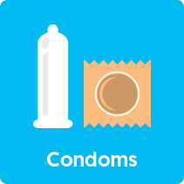
GIO Scheme - under 25’s
Condoms by Post - 16+
www.letstalkaboutit.nhs.uk/condoms
Sexual Health Clinics
www.letstalkaboutit.nhs.uk/getiton
www.hants.gov.uk/getiton
Notes:
Condoms are FREE from the NHS
In Hampshire, Portsmouth, Southampton & IoW you can get free condoms
Can also buy online and in supermarkets

Slide 26
HIV Prevention

Slide 27
42% never had an HIV test
77% never had an HIV test
84% never had an HIV test
https://www.tht.org.uk/news/77-people-uk-have-never-had-hiv-test
Notes:
YouGov polling of over 2,000 UK adults.

Slide 28
The only way to know your HIV status is to have a test.
Notes:
Testing regularly allows people to be diagnosed early. Thereby starting treatment and improving long term health outcomes, avoiding damage done by untreated HIV, and reduces onward transmission of HIV.
How often someone should test? Depends on the person and individual risk. Multiple partners every 3 months or annually if sexual active, and at start new relationship?

Slide 29
 | IV blood test | Point of Care test | Self sampling | Self testing kit
Availability | Free in clinic | Free in clinic or community | Free from NHS, do at home. | Purchase, do at home
Sample method | Taken by clinician from arm | Taken by clinician from finger prick | Taken by patient from finger prick | Taken by patient, (sample depends on test)
Sample amount | 1 tube | 1 small drop | 1 small tube | Depends on test
Time for results | 7 working days | 60 seconds | 7 working days | Depends on test
Window Period | 45 days | 90 days | 45 days | Depends on test
Notes:
Tests will always need a confirmatory test if reactive.
Home kits legal in 2014. Home kits that provide results will have advice on what to do if result is reactive.
As you can see there are different window periods depending on the type of test. If unsure when to test, test now, and do another later.
Reactive result.

Slide 30
https://www.tht.org.uk/news/lockdown-sex-ban-could-break-chain-hiv
Notes:
During the first COVID-19 lockdown, THT ran the above campaign. The logic behind the campaign is that during lockdown, people wouldn’t be hooking up. Therefore, the window periods of testing will likely have passed, so they can conduct a test (at home) and the result would be accurate.

Slide 31
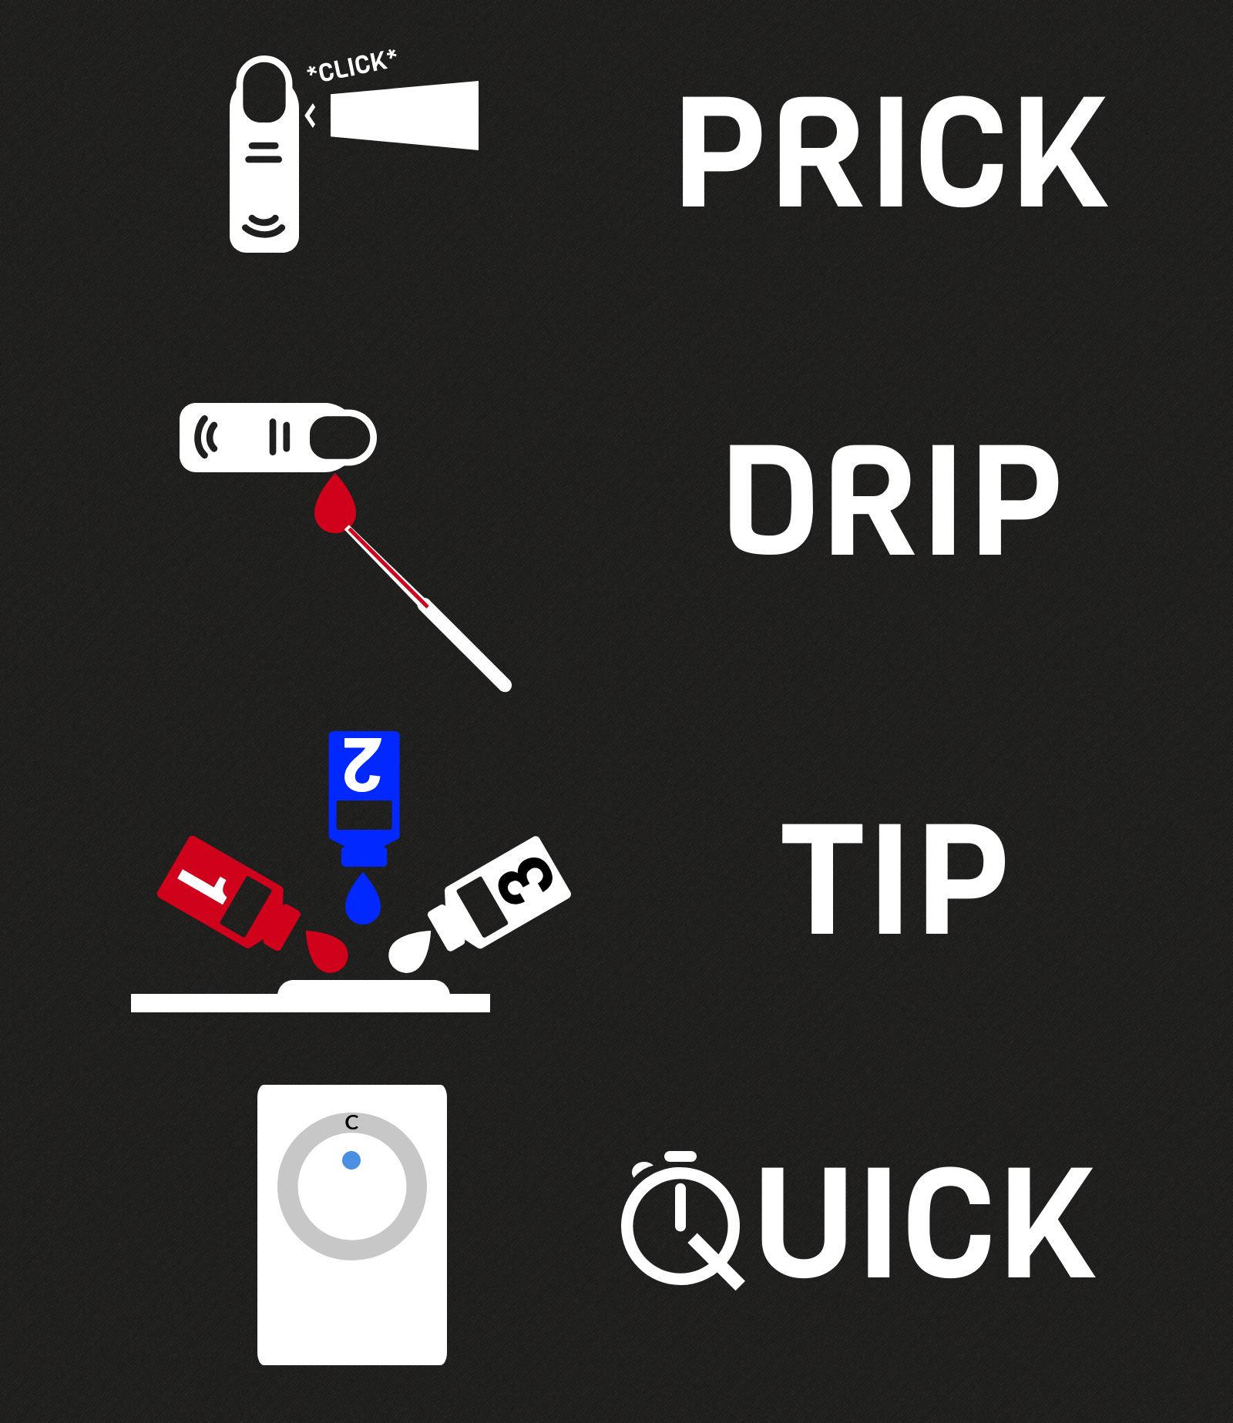
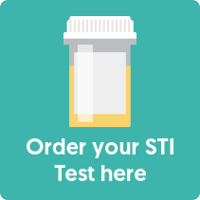
Community Rapid Test
(Currently suspended)
www.letstalkaboutit.nhs.uk/hivtest
Full STI Kit (18+)
www.letstalkaboutit.nhs.uk/test
Sexual Health Clinic
Notes:
Community POCT testing – takes the testing to the community. Overcomes some barriers. Pharmacies/Saunas/Bars
GPs may offer testing – Some people may feel more comfortable to attend a GP surgery. If someone asks for a test, don’t be afraid to do one for them! Our service is here to help and support your patient and you as a professional. Referral details will be at the end of the presentation.

Slide 32
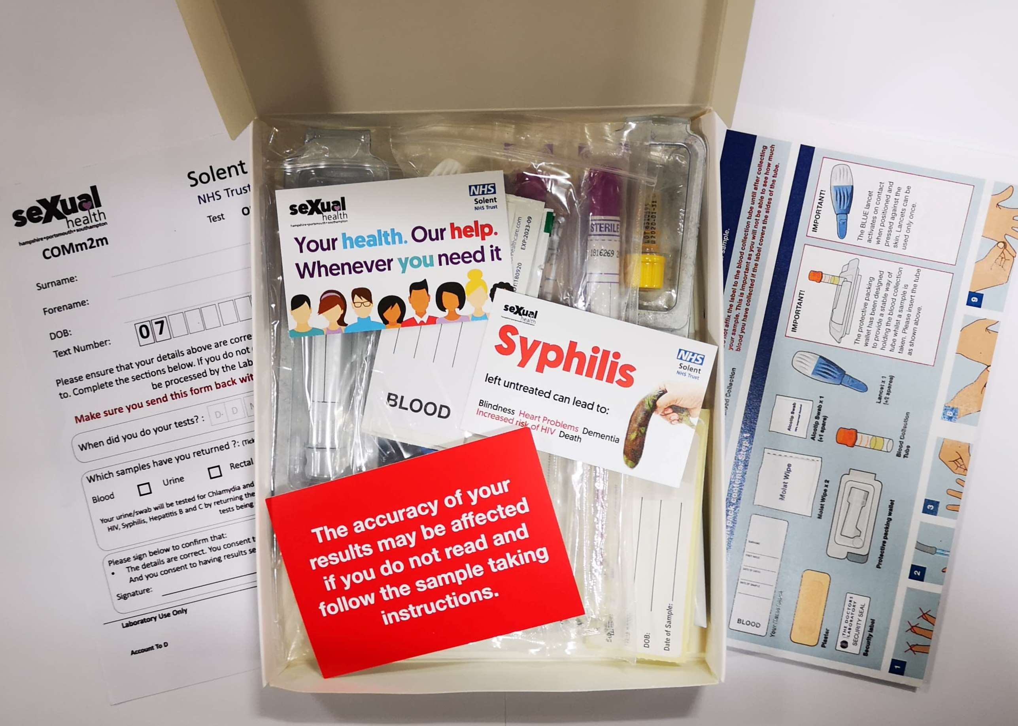
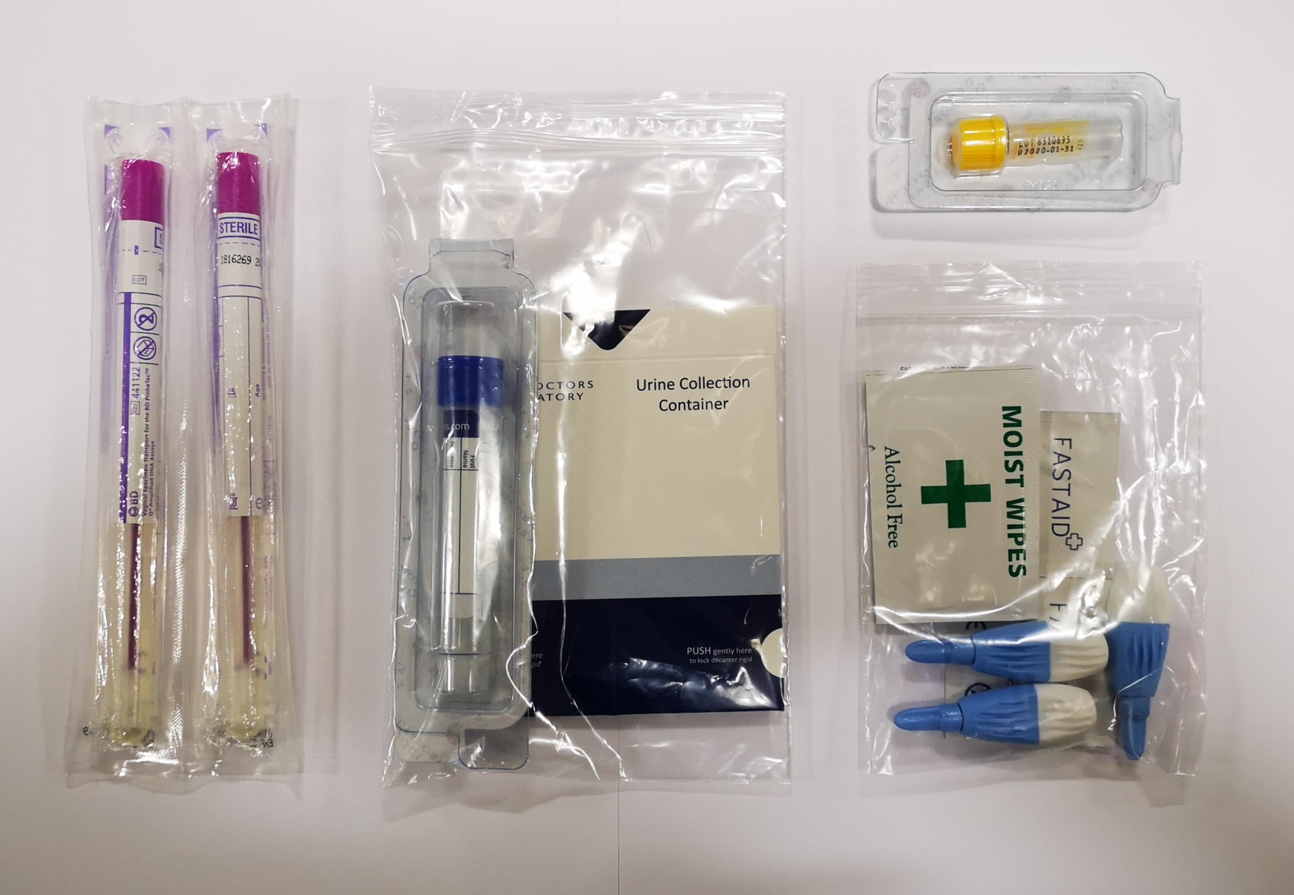
Free.
Confidential.
Discreet packaging.
www.letstalkaboutit.nhs.uk/test
Notes:
Full kit contains: Chlamydia, Gonorrhoea, Syphilis, HIV (Hep B&C for MSM)
Self taken blood sample, and urine/swabs
All FREE

Slide 33
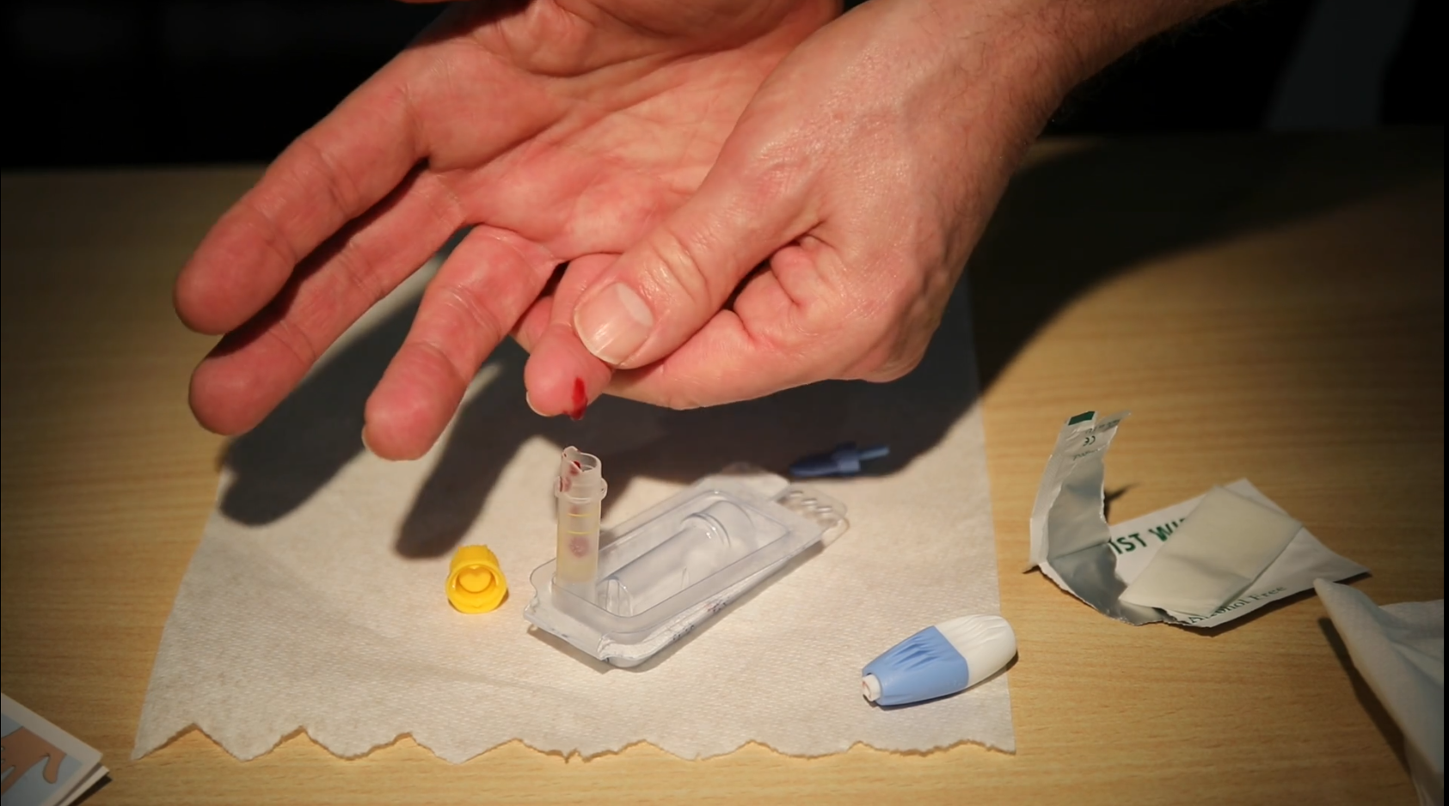
www.letstalkaboutit.nhs.uk/blood
Notes:
Only the blood test from our kits will test for HIV (+ Syphilis, Hep B&C). The swabs/urine will not test for HIV.
Very important to complete the blood sample for HIV test.
If you have trouble taking a blood sample, we have made a video available on our website.
Allow time, follow the instructions carefully.

Slide 34
www.startswithme.org.uk/which-test
www.startswithme.org.uk/when-to-test
Notes:
Not sure when to test or which test is right? You can use these tools to find out.

Slide 35
https://www.tht.org.uk/our-work/community-projects/hiv-prevention-england
Notes:
HIV testing week is a UK based campaign running annually. Usually November, but this year was delayed until Feb 2021. It coincided with the release of It’s A Sin and saw the same amount of kit orders in day 1 compared to the whole week the previous year. 10000 HIV only kits commissioned and available nationally, had to get funding for more! This was on top of locally available services.

Slide 36
HIV Prevention

Slide 37
https://www.youtube.com/watch?v=0BQX8s1R_74
Notes:
How treatment works – in a nutshell

Slide 38
The natural history of HIV without ART
HIV after starting ART
https://i-base.info/guides/wp-content/uploads/2019/05/ART-in-pictures-June-2019e.pdf
https://i-base.info/guides/art-in-pictures
Notes:
Virus uses CD4 to make more copies of itself
Treatment puts it on strike so can’t make any more.
Doesn’t take it away – suppresses it so it doesn’t make enough copies to be detected.
Treatment is a combination of drugs.
Groups of drugs – combination of two or three drugs. Work in different parts.
BHIVA treatment guidelines – Preferred options, and alternatives.
Can be as simple as one tablet a day. Often once a day, no food restrictions
Early HIV treatment = Lots of tablets at many different times a day. Often with side effects, with food and water restrictions.
It is now recommended that treatment is started as soon as diagnosed. Previously it was when the immune system started to become weakened.
Treatment allows the immune system to repair itself and prevent further damage.
Higher CD4 when starting treatment, the higher it will ‘recover’ to.
Most people living with HIV never experience late-stage HIV, though it depends on a range of factors
Most people with early diagnosis and effective treatment will live a near-normal lifespan.

Slide 39
Drug levels and adherence
https://i-base.info/guides/wp-content/uploads/2019/05/ART-in-pictures-June-2019e.pdf
https://i-base.info/guides/art-in-pictures
Notes:
Importance to adhere very well – Risk of non-adherence is resistance and increase in viral load.
HIV that is inside sleeping CD4 cells cannot be reached by ART
Some of these cells can also sleep for decades. But they can also wake up at any time and the timing is not predictable. This is one reason why ART needs to be taken every day.
This is also why viral load generally rebounds if ART is stopped – even after many years on treatment.
Future of treatment: Integrase inhibitors – Two drugs in one tablet – less medication, less side effects, less impact on body, less contraindications. “clean safe drug”
Potential for monthly tablets, injectables, implants.
Thanks to Suzanne, Specialist HIV Pharmacist

Slide 40
www.tht.org.uk/cantpassiton
Notes:
You might be asking why we have included Treatment as one of the HIV prevention methods.
If there is one thing to take away from today and shout from the rooftops it is this. People on effective HIV treatment CANNOT pass on the virus. Fact.
The landmark PARTNER study, published in 2016, looked at 58,000 instances of sex without a condom where one partner was HIV positive and one was HIV negative.
Results found that where the HIV positive partner was on effective treatment (reducing the amount of the virus to ‘undetectable’ levels; also known as having an undetectable viral load), there were zero cases of HIV transmission. This is what is meant by the phrase Undetectable equals Untransmittable (U=U).
This was further backed up in the PARTNER 2 study, published in May 2019, which also showed zero cases of transmission among 782 gay male couples.
Different risk between anal/vaginal sex, hence second study.

Slide 41
https://i-base.info/u-equals-u/
Notes:
Also known as U=U.
Viral load below 200 for more than 6 months.

Slide 42
HIV Prevention

Slide 43
Pr E P
Pre
Exposure
Prophylaxis
PrEP is a pill
that protects
you from HIV
Notes:
Pre = Before
Exposure = Risk of transmission
Prophylaxis = preventative treatment
PrEP is a pill that protects you from HIV.

Slide 44
Taken before and after sex.
Daily
(for anal and vaginal sex)
or
Event based
(for anal sex or straight men having vaginal sex)
99%
effective
https://i-base.info/guides/prep
https://www.tht.org.uk/hiv-and-sexual-health/prep-pre-exposure-prophylaxis
Notes:
PrEP is drugs which are used to treat HIV. But taking these drugs before exposure means there is enough of the drug in your body to stop HIV taking hold if it gets in your body.
There are different ways to take PrEP.
Daily, once a day. Good for spontaneous unplanned sex – Only option for vaginal sex.
Or event based, before and after an episode of sex. Good if your sex is more planned, and taking less drug. Only for certain kinds of sex.
PrEP is more than 99% effective at stopping HIV infection. when taken correctly.
PrEP only protects against HIV. Condoms still recommended for other STIs.

Slide 45
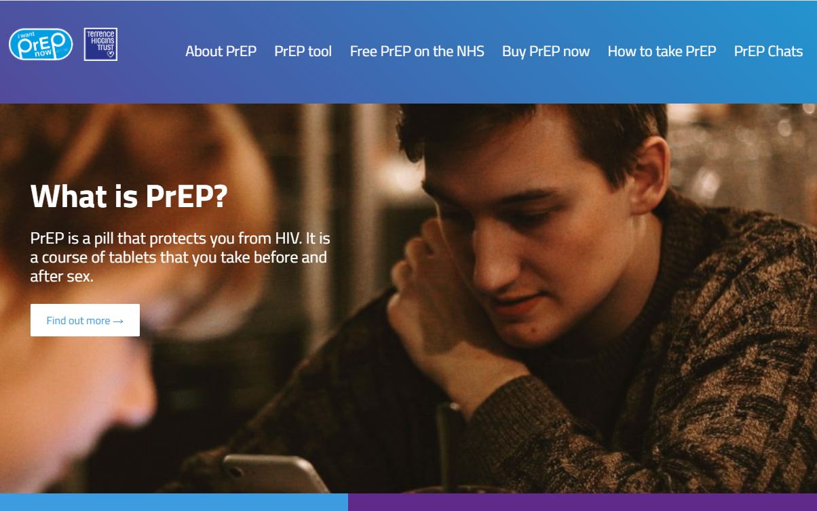
https://www.iwantprepnow.co.uk/
https://prepster.info/
https://www.bbc.co.uk/news/stories-44606711
https://www.bbc.co.uk/programmes/b0b8cdm4
Notes:
The People vs The NHS – Who gets the drugs?
Greg Owen – Dr Mags Portman, just to name a few of many
I want PrEP now – set up to allow people in the UK to legally buy PrEP from overseas sellers (legal for personal use)
Clinics did testing on the drugs purchased to confirm legitimate. Clinics also offered free testing and monitoring to those who purchased own drugs.
In England, PrEP Impact train, 13000 spaces expanded to 26000 – For those meeting criteria, not just MSM. 2017-2020.
Commissioned on NHS in England for those who meet eligibility criteria in March 2020, and rolled out from October 2020.
NAT took England to court for rollout of PrEP 2015

Slide 46
Who should consider taking PrEP?
A. Men and transgender women who:
Have sex with men
AND have had an HIV negative test during in the preceding year
AND report condomless sex (excluding oral) in the previous 6 months
AND are likely to continue having condomless sex (excluding oral)
B. HIV negative partners of an HIV positive person when:
The HIV positive partner is not known to be virally suppressed (<200 copies/ml for 6 months or more)
AND condomless sex (excluding oral) is anticipated before treatment of the HIV positive partner takes effect
C. Other HIV negative people assessed to be at high risk of HIV acquisition.
This may include people having condomless sex (excluding oral) with partners from parts of the world where HIV is common (such as Southern Africa, Southeast Asia and the Caribbean), and commercial sex workers or their clients who report regular condomless sex.
Sexual Health Clinic
www.letstalkaboutit.nhs.uk/prep
Notes:
PrEP isn’t a pill for gay men. It can be for anyone who is at increased risk of HIV transmission.
Useful for situations where negotiation of condom use is absent or difficult.
PrEP is safe for Trans people and will not interact with hormone medication.
Over 15s on a case by case basis
Blood and urine tests before starting – check HIV negative, check kidneys. Regular monitoring and STI screening as part of provision.
Future of PrEP – currently only available in SH clinics. Barriers exist towards people accessing sexual health generally, even more so for certain populations where additional stigma is attached. Need it in GP etc.
Vaginal ring, injections, implants, weekly tablets.

Slide 47
www.startswithme.org.uk/prep-tool
Notes:
Useful PrEP tool – for those unsure if PrEP is right for them.

Slide 48
https://www.hivpreventionengland.org.uk/2020/09/22/new-prep-campaign-launching-in-october-2020/
Notes:
Campaign from It Starts With Me – October 2020, aimed at Black African populations. Lower uptake. But as we have seen from stats, disproportionately affected by HIV. PrEP as a tool of self empowerment and taking control of own health.

Slide 49
HIV Prevention

Slide 50
P E P
Post
Exposure
Prophylaxis
Notes:
Post = after
Exposure = risk of HIV transmission
Prophylaxis = preventative medicine/treatment
Medication you take after a risk of HIV transmission has occurred to reduce the risk of HIV taking hold if in your body.
Similarly to PrEP, it is HIV treatment drugs.

Slide 51
72 hours, but get
AS SOON
AS POSSIBLE
A&E
Sexual Health Clinic
Accident & Emergency
Notes:
ASAP. Can’t take after 72 hours
28 day course – do not miss doses!
Follow up and testing via Sexual Health Clinics.
Guidelines from BASHH on when PEP should be recommended. Always seek help and advice, but circumstances depend on if PEP is given.
In hours, get from Sexual Health.
If closed, A&E.

Slide 52
EMERGENCY ONLY
PEP is not a long term prevention method to be relied upon.
Notes:
Do not rely on PEP
Analogy
PrEP = Contraceptive Pill
PEP = EHC morning after pill – not to be relied upon.

Slide 53
Reducing Stigma
are you clean?
48%
38%
uncomfortable kissing someone living with HIV
uncomfortable going on a date with someone living with HIV
https://www.tht.org.uk/news/almost-half-brits-would-feel-uncomfortable-kissing-someone-hiv
Notes:
“Are you clean” is still a phrase used to describe being free of STI infection, including HIV. Especially on MSM dating apps.
The YouGov survey of 2,075 Brits also uncovered shocking levels of HIV stigma, including that almost half (48%) would feel uncomfortable kissing someone living with HIV, while 38% would feel uncomfortable going on a date with someone who is HIV positive.

Slide 54
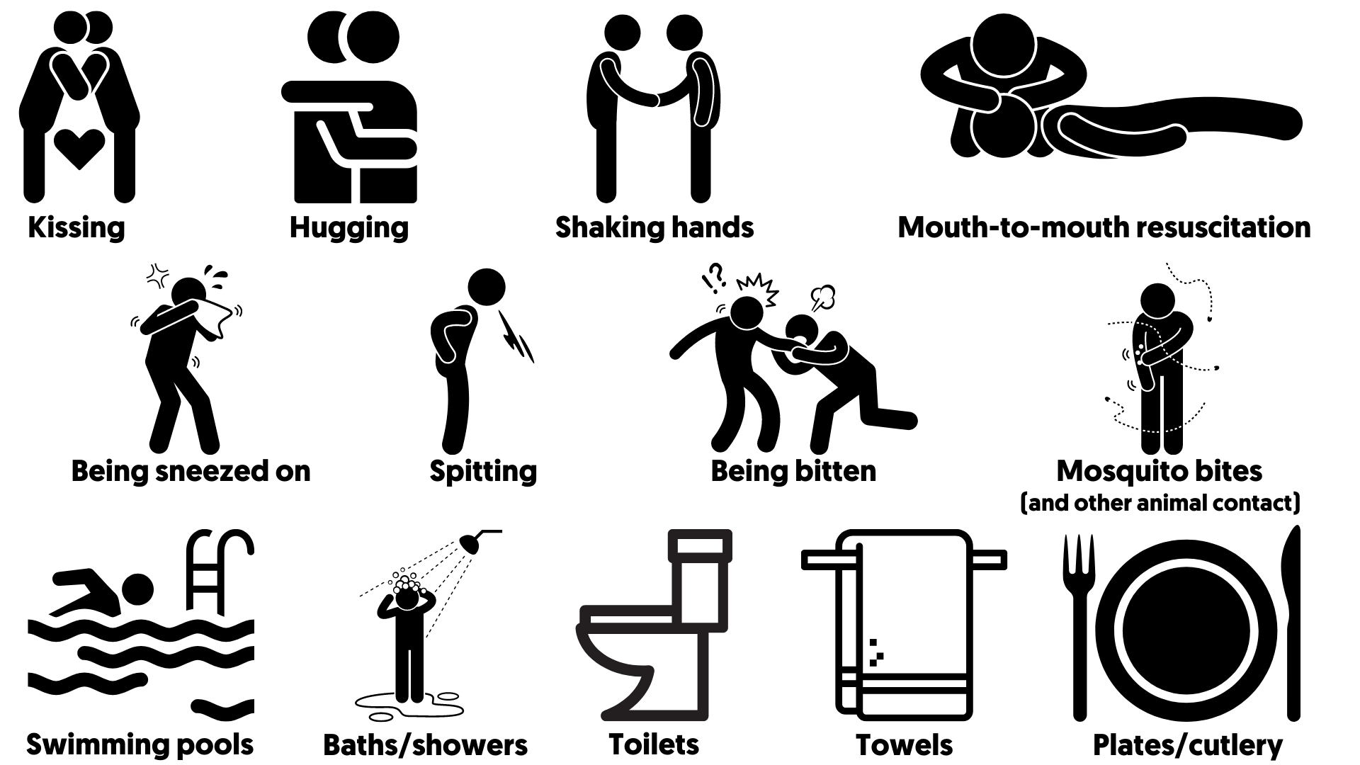
Reducing Stigma
HIV cannot be transmitted by
Notes:
We know HIV cannot be transmitted via these routes.
Unfortunately a lot of misconceptions exist around HIV transmission.
Media a few years ago about ‘spit hoods’ protecting police from HIV
HIV is a coward virus outside the body. There has been no “discarded needle” transmissions.
Hepatitis higher risk.

Slide 55
Reducing Stigma – Famous Faces
AP, (1987), https://time.com/5793707/diana-princess-of-wales-100-women-of-the-year/
Encyclopædia Britannica https://www.britannica.com/biography/Freddie-Mercury/images-videos#/media/1/711409/236626
https://tacklehiv.org
Notes:
In 1987 Princess Diana reduced a lot of stigma around HIV by shaking hands with people living with HIV without wearing gloves, showing that HIV cannot be transmitted this way. In 1991, Diana gave a speech at the Children and AIDS Conference, saying: “HIV does not make people dangerous to know. You can shake their hands and give them a hug. Heaven knows they need it.” and that “You can share their homes, playgrounds and toys”
In 1991 Queen singer Freddie Mercury died of AIDS related illness, only one day after publicly announcing he was living with HIV and had been diagnosed with AIDS. He was one of the most prominent names to have been affected by HIV/AIDS.
In 2019, Welsh Rugby player Gareth Thomas announced that he was living with HIV. He took the decision to announce this publicly after pressure from media potentially exposing his diagnosis. Gareth has launched the Tackle HIV campaign which aims to reduce HIV Stigma. So even today, people living with HIV face stigma.

Slide 56
Reducing Stigma
Equality Act 2010
Protected Characteristics
Age
Disability
Gender Reassignment
Marriage & Civil Partnership
Pregnancy & Maternity
Race
Religion & Belief
Sex
Sexual Orientation
Disability
Notes:
People living with HIV are classed as living with a disability under the Equalities Act 2010. This is a protected characteristic when it comes to employment and provision of service. It is against the law to discriminate against someone living with HIV.
Despite the fact that people living with HIV are protected by the Equality Act 2010, people living with HIV face discrimination in employment, access to services and often in their personal lives.
Work as pilots and surgeons and other healthcare roles. Guidance in place to support workers. TV doctor was talking about HCW and Covid and said that you wouldn’t expect someone living with HIV to be a surgeon.

Slide 57
Reducing Stigma
Normalise Testing
Opt-out, not opt-in.
Antenatal HIV Screening
This is routine, opt-out.
99% testing coverage.
www.hivcommission.org.uk
Notes:
Sexual Health as part of overall health. Treat it like dentist, optician. Regular and done by everyone.
This will reduce late diagnosis.
Opt-out testing – HIV Commission
All GP registrations
A&E admissions
HIV Indicator testing hospitals
HIV indicator testing in GPs
Cervical screening
Testing offered by community pharmacies, including POCT rapid tests.
TOP clinics
Substance misuse service.

Slide 58
Reducing Stigma
“People living with HIV often experience stigma within the healthcare system itself, which acts as a barrier to people living with HIV accessing services.
This stigma also indicates that not all of the health and social care workforce has sufficient up-to-date knowledge of HIV, which can also mean that HIV indicator conditions go unnoticed” (HIV Commission, 2020)
www.hivcommission.org.uk
Notes:
Stigma remains deeply bound up in other discriminations, with racism, xenophobia, transphobia, sexism and homophobia all playing key roles in continued stigma and misconceptions about people who live with HIV.
We must increase the knowledge and awareness of HIV amongst the general healthcare workforce. Too often we heard accounts of stigma experienced within the healthcare system, including nurses ‘double-gloving’ and multiple accounts of appointments being moved to the end of the day so rooms could be ‘decontaminated’. This exposes a serious problem in the level of knowledge among some healthcare staff who don’t know or believe that a person with an undetectable viral load cannot transmit HIV – this is known as undetectable = untransmittable or U=U. This perpetuates stigma and leaves people living with HIV deterred from engaging with care. Not only this, but it is symptomatic of other problems: that many healthcare staff are not aware of indicators of HIV and believe that it only affects certain minority groups. This can lead to patients being seriously ill before they are tested for HIV.
Double gloving, last appointment of day for dentists. Existing IPC measures for blood borne viruses are enough to protect healthcare workers and patients.

Slide 59
Reducing Stigma
Who to tell?
Notes:
Disclosure of HIV status
Some don’t’ disclose to their GP
Disclosure to Sexual partner?
Think about the Pros and Cons.
Generally we advise that they don't have to disclose to anyone (employers or Partners) but discuss reasons that would prevent this, also discuss the advantages of employers knowing ie time off for appts/support ect and same with relationships and long as sex is protected but again how would they feel if it developed into a long term relationship.
Legalities.

Slide 60
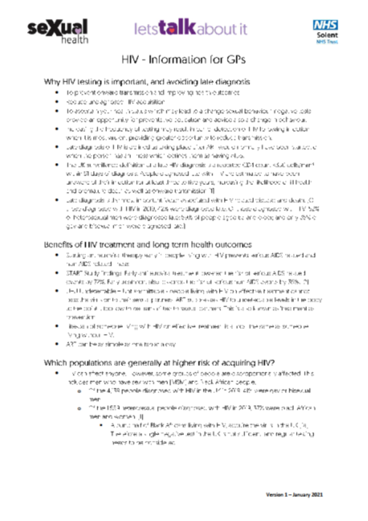
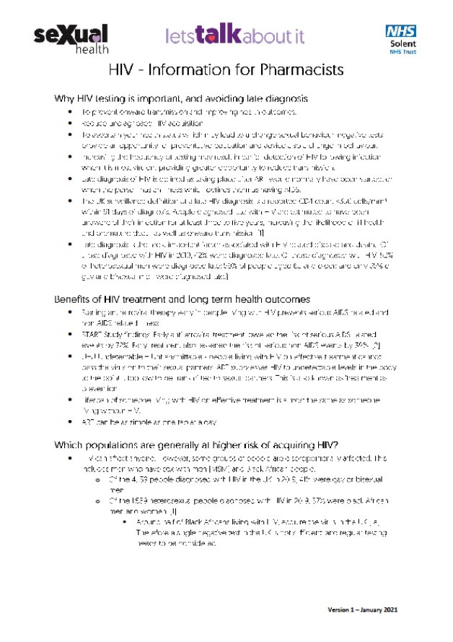
GP & Pharmacist Information Sheet
www.letstalkaboutit.nhs.uk/hivinfo
Notes:
We have developed The sheet contains information on the following:
Why HIV testing is important, and avoiding late diagnosis
Benefits of HIV treatment and long-term health outcomes
Which populations are generally at higher risk of acquiring HIV?
Local HIV testing options
Barriers to testing
Referral information for further support
Confidentiality
Areas of high HIV Prevalence
For GPs: Clinical indicators to consider signposting to or offering HIV test
For Pharmacists: Training for Pharmacists on HIV and Sexual Health

Slide 61
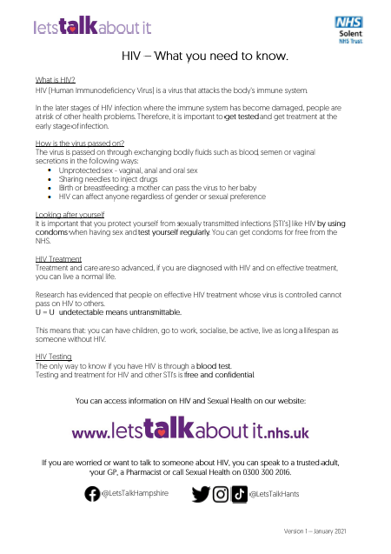
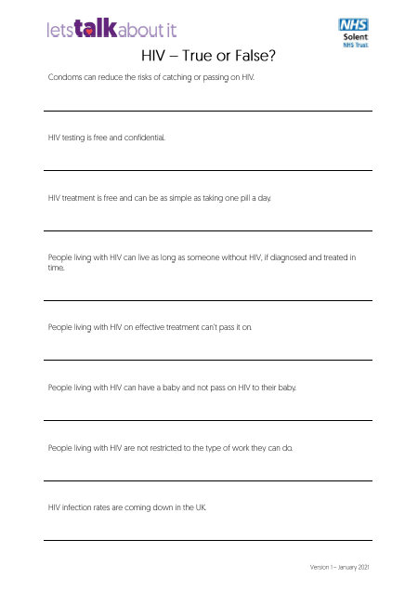
Relationships and Sex Education HIV Resources
www.letstalkaboutit.nhs.uk/hivteach
Notes:
The free resource aims to give learners a basic introduction to HIV, and signpost them to local support services. The resource is adaptable and can be incorporated to teaching in the most appropriate way for your learners. This resource is targeted for learners age 13+. This resource can be used at the teacher’s discretion and adapted according to time and student need. It does not need to be delivered in a traditional lesson format.
Learning Outcomes
Young people will have increased knowledge of HIV including prevention, transmission and the importance of testing and treatment and how to access services
They will have an understanding of how people live with HIV, including healthcare, lifestyle and rights.

Slide 62
Relationships and Sex Education HIV Resources
Facilitators Guide
www.letstalkaboutit.nhs.uk/hivteach
Notes:
Facilitators guide: A guide for educators on how to use the resource. Also gives additional information to discuss around each of the statements on the exercise. Further information on HIV and Sexual Health is included in the facilitators guide to enable them to answer questions from learners, and signpost where appropriate.
Learning Outcomes
How to use the activity resource
Appropriate language – Terminology guide
Why the term AIDS isn’t widely used any more
Activity Statements – enhanced breakdown for the facilitator to give additional verbal information to learners on each statement.
Further information for teachers – this is not necessarily to be shared with learners, but to enable teachers to have an enhanced knowledge of HIV to answer any potential questions.
Things to be aware of - Some learners may be living with HIV or know someone living with HIV, You may be delivering to learners who fall into higher risk categories.
Further advice and signposting, including how to make a referral for one to one support.

Slide 63
Relationships and Sex Education HIV Resources
Learner Fact Sheet
What is HIV?
How is the virus passed on?
Looking after yourself
HIV treatment
HIV testing
Signposting
www.letstalkaboutit.nhs.uk/hivteach
Notes:
Learner Factsheet: information on HIV, testing and treatment.
Gives a short background on what HIV is, transmission, how to prevent and look after yourself, HIV treatment & testing. Preparing them in part for the next task.
There is also signposting to general SH information at the bottom of the page. They can take this away with them to keep.
We haven’t branded this with the SH logo, we used LTAI as memorable for the website.

Slide 64
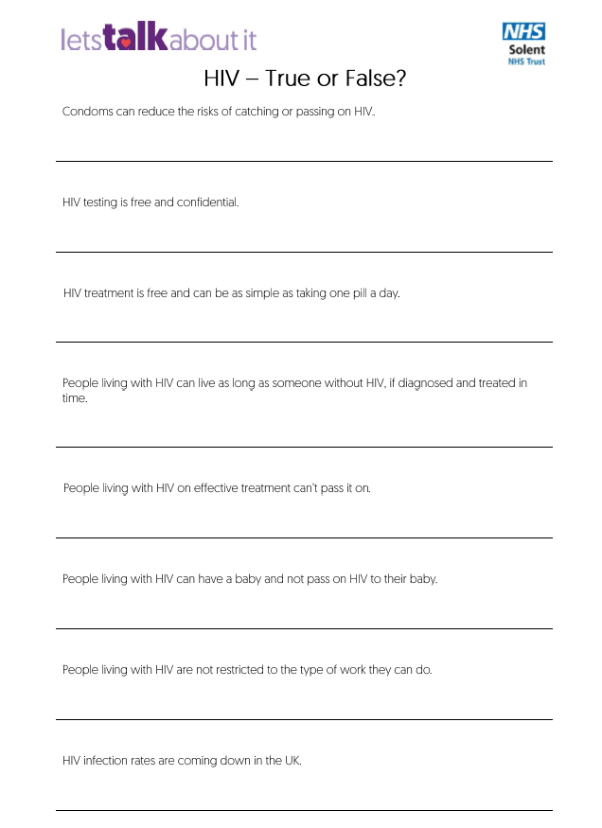
Relationships and Sex Education HIV Resources
Learner Worksheet
True or False?
Condoms can reduce the risks of catching or passing on HIV.
HIV testing is free and confidential.
HIV treatment is free and can be as simple as taking one pill a day.
People living with HIV can live as long as someone without HIV, if diagnosed and treated in time.
People living with HIV on effective treatment can’t pass it on.
People living with HIV can have a baby and not pass on HIV to their baby.
People living with HIV are not restricted to the type of work they can do.
HIV infection rates are coming down in the UK.
www.letstalkaboutit.nhs.uk/hivteach
Notes:
True or False Exercise: A task to allow learners to put their HIV knowledge to the test.
Worksheet: Statements with a space to write True or False
All of the statements are True – and they all have a positive message behind them.
Can be left at the worksheet, and the answers talked through verbally. Or used in conjunction with presentation

Slide 65
Relationships and Sex Education HIV Resources
Presentation
www.letstalkaboutit.nhs.uk/hivteach
Notes:
True or False Exercise: A task to allow learners to put their HIV knowledge to the test.
Presentation: Statements, followed by immediate True or False answer. Best for doing as a group activity – or used in combination with the worksheet.
This is an adaptable resource.

Slide 66
Support and More Information
www.tht.org.uk
www.nat.org.uk
https://i-base.info
www.startswithme.org.uk
www.aidsmap.com
www.nhs.uk/conditions/hiv-and-aids

Slide 67
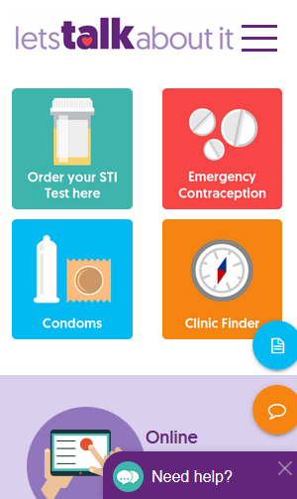
How to make a referral
Non-Urgent HIV Referral form available at www.letstalkaboutit.nhs.uk/referrals
Complete relevant sections
Send to: snhs.sexualhealthreferral@nhs.net
Urgent HIV Referral process www.letstalkaboutit.nhs.uk/referrals
It is always necessary to gain the patients consent prior to a Sexual Health referral being made.

Slide 68
Sexual Health Promotion Support
If you need more information about services, support or training, please contact the team:
solentsexualhealthpromotion@solent.nhs.uk
SNHS.sexualhealthpromotion@nhs.net (Patient Identifiable Information)
or speak to your local sexual health promotion practitioner directly

Slide 69
Accessing our service
Online:
Online Testing
Condoms By Post
24/7 ‘Need Help’ Facility
Advice and Information
Support for young people
Clinic Finder
Referrals
Specialist Clinics
Information for Professionals
You can find details of the nearest
sexual health clinic at: www.letstalkaboutit.nhs.uk
Click the clinic finder button
Or call: 0300 300 2016

Slide 70
Personal Health Record (PHR)
Solent Sexual Health Services have launched a new Personal Health Record (PHR) for our patients
PHR brings together Appointment Booking, STI Test Kit ordering and Condoms by Post all in one place
www.letstalkaboutit.nhs.uk/personal-health-record

Slide 71
Don’t forget!
Free &
Confidential
Notes:
All HIV testing treatment and care is free to all in the UK. Regardless of immigration status.
Sexual Health records are separate from other GP and hospital health records. Information only shared with consent.

Slide 72
https://www.youtube.com/watch?v=fI-9vh5QYGM

Slide 73
Social Media
@LetsTalkHampshire
@LetsTalkHants

