Slide 1
Solent NHS Trust Sexual Health Service
Notes:
This is a presentation to introduce the Sexual Health services to young people, to raise awareness on services provided, how to access the service, what to expect and also some basic education on STI’s. There is an interactive quiz and several videos, which you can utilise depending on timeframe available for the session. The videos all have time details included. Please have a quick run through first and make sure the notes are clear enough for you. If there are any questions or issues, please speak with the worker who sent you the presentation.

Slide 2
About Sexual Health Services
All sexual health services are free, confidential and non-judgemental. We promise to treat everyone with kindness and respect. Your health, wellbeing and safety is our priority.
We promote equality with due regard to protected characteristics, which means we offer inclusive services regardless of religion, ethnicity, sexuality and gender identity.
Notes:
Sexual Health Service are free and available for everyone. More information about Solent’s Equality, Diversity and Inclusion Policy available here: https://www.solent.nhs.uk/our-story/equality-diversity-and-inclusion/
For example, we will address you by your preferred pronouns or name.

Slide 3
What are Sexual Health Services?
Provide health care for sexual health needs:
Testing and Treatment of Sexually Transmitted Infections (STI’s)
Contraception
Emergency Contraception (EHC)
Pregnancy testing
Unplanned Pregnancy Advice (BPAS)
Sexual Health 1:1 Support
Services are open to anyone regardless of age

Slide 4
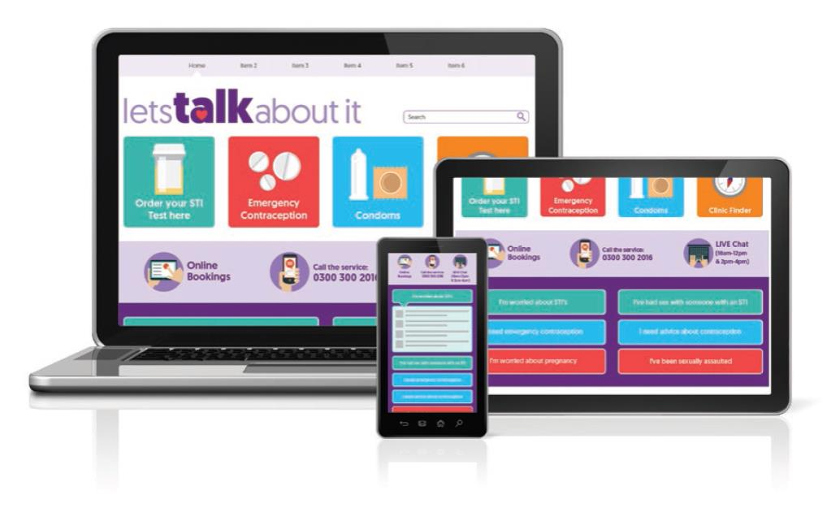
How to access Sexual Health
Appointments
Phone: 0300 300 2016
Online Bookings
Walk-In: Young Person’s Walk In Clinic
Information & Advice Website:
www.letstalkaboutit.nhs.uk

Slide 5
Your Nearest Sexual Health Clinic
You can find details of your nearest sexual health clinic at:
www.letstalkaboutit.nhs.uk
0300 300 2016
Click the clinic finder button
Notes:
Facilitator can check this information with their sexual health practitioner contact or obtain current information from: https://www.letstalkaboutit.nhs.uk/clinic-finder/

Slide 6
What are Sexually Transmitted Infections (STI’s)?
Bacterial infections, viruses or infestations that are passed from one person to another through sexual contact, vaginal, anal and oral sex.
STIs can pass between any person to any person, regardless of gender or sexual identity
Notes:
More information about different types of STIs can be found at https://www.letstalkaboutit.nhs.uk/worried-about-stis/information-about-common-stis/ or https://www.nhs.uk/live-well/sexual-health/

Slide 7
What are Sexually Transmitted Infections (STI’s)?
Chlamydia is the most commonly diagnosed STI in people aged under 25
Most people who have Chlamydia don’t show any symptoms, so its important to get a test if you have had unprotected sex (sex without a condom)
Young people should be aware of how to get a test and treatment for Chlamydia to protect themselves and their partner
Notes:
More information about Chlamydia is available at https://www.nhs.uk/conditions/chlamydia/
Young people aged 15-24 can get a free test for Chlamydia online at www.letstalkaboutit.nhs.uk. They can also visit a Sexual health clinic or a GP.

Slide 8
What is Contraception?
Contraception prevents pregnancy
Some methods are long-lasting (fit & forget)
Some methods rely on the person taking them regularly (i.e. pill) or each time they have sex (condom)
Emergency Contraception (morning after pill) is taken after the incident of unprotected sex or failed contraception (e.g. split condom/ missed pills)
It is the responsibility of both of you and your partner to use contraception
Notes:
Information about contraception is available: https://www.letstalkaboutit.nhs.uk/contraception/ or https://www.sexwise.org.uk/contraception
Emergency Contraception must be taken as soon as possible following unprotected sex, i.e without any contraception - as it works best to stop pregnancy the sooner it is taken.
More information available at: https://www.letstalkaboutit.nhs.uk/pregnancy-worries/emergency-contraception/

Slide 9
What is ‘fit & forget’ contraception?
‘Fit & Forget’ or ‘LARC’ is contraception that works in the longer term
The coil and implant get inserted once and then last for years (depending on type)
They can be removed when you’re ready
Many people choose longer methods because it fits in with their life style (i.e. you don’t have to remember to take a pill everyday)
Everyone is different – what works for you may not work for someone else
Notes:
LARC = Long Acting Reversible Contraception
More information about the myths of fit and forget contraception can be found here: https://www.letstalkaboutit.nhs.uk/contraception/fit-forget-contraception/

Slide 10
Common methods of contraception
External condom
Pills
Coil
Implant
Internal condom
Depo Injection
Notes:
External condom (male condom – worn on the penis) – video for how to put on a condom available at https://www.letstalkaboutit.nhs.uk/contraception/condoms/ (also featured later in presentation)
Internal condom (female condom – inserted into the vagina)
Implant – inserted into upper arm – lasts up to 3 years – discreet
Depo Injection – every 12-13 weeks
Coil – inserted through vagina, sits in the womb 5-10 years depending on type
Pills – hormonal & non-hormonal available
All contraception options will be discussed in more depth with a Sexual Health Nurse at the clinic. It is the young persons decision about which contraception method to choose, but the nurse will talk through life style and options to support them to make an appropriate decision – not everyone is the same.

Slide 11
Click here for video on how to access Sexual Health Services (sound on)
The following slides are interactive.
If you are short on time, please move to here
Video & Quiz
Notes:
Slides 13 to 30 - Interactive quiz with answers (true/False questions on separate slides, answer slide immediately after each question slide)
Video link: https://vimeo.com/461829208

Slide 12
You need to give and have enthusiastic consent from the person you are going to have sex with
True False
Notes:
Use this quiz to challenge myths and misconceptions.
You can ask students to shout out their answers or give them each a card with “True/False” written and ask them to hold up their answers – this will enable everyone to engage.
You can address incorrect answers after each question, and you may identify further learning needs for your students.
Information about consent and recognising signs of consent available here: https://www.disrespectnobody.co.uk/

Slide 13
TRUE
Consent is giving permission freely without being pressurised, persuaded or coerced
Consent is clear and enthusiastic
A person can decide to stop an activity at any time, even if they agreed to it before
If someone has been drinking alcohol, or taking drugs, they may not be able to consent to sex
If someone is asleep or unconscious, they cannot give consent.
Consent video 3mins

Slide 14
If you are under 16 you can get free and confidential advice and care from Sexual Health Services without your parents/guardian permission
True False

Slide 15
TRUE
Our service is confidential. If you're 13 to 15 years old, you have the same rights to confidentiality as an adult
Your information is not shared with anyone else (doctors, schools, parents)
The only time we will share information is if we think you or others are at harm or at risk.
We will talk to you about confidentiality at your appointment.
Notes:
16-18 year olds also have the same rights as an adult due to the age of consent being 16
13-15 year olds can access sexual health services without permission from a parent/guardian but we would always encourage them to talk to a trusted adult about sexual health and if they are worried and for support.

Slide 16
Sexually Transmitted Infections (STI’s) can impact your health
True False

Slide 17
TRUE
If left untreated, many sexually transmitted infections can be painful or uncomfortable
They can be passed on to someone else
If undiagnosed and untreated, some infections may have lasting health consequences

Slide 18
You will not always know if you have a Sexually Transmitted Infection
True False

Slide 19
TRUE
Not everyone who has a sexually transmitted infection has signs and/or symptoms
Some STI’s may not show symptoms for months or even years
Chlamydia is the most common STI in your age group
We can test for some Sexually Transmitted Infections even if you don’t have symptoms
Other infections can only be diagnosed if you have symptoms such as Warts or Herpes
Notes:
Some infections such as warts and herpes are diagnosed through physical/visual examination.

Slide 20
A doctor/nurse may need to examine you to diagnose a Sexually Transmitted Infection
True False

Slide 21
TRUE
Many tests are completed by you (urine or self taken swab) but some STIs may need a nurse/doctor to examine you
They will discuss this with you before any examination so that you can talk about any worries or concerns you may have
We will always ask for your consent before a physical examination
You will be offered a chaperone to come in to the room to support you during any physical examination
We know this can feel uncomfortable but everyone is always treated with dignity and respect and it usually only takes a few minutes.
A Chlamydia test is a urine sample or self-taken vaginal swab
Notes:
Most tests can be completed without a physical examination. If the nurse or doctor needs to examine someone, we will discuss this with them and gain their consent. A chaperone (another sexual health professional) will be provided to support them during any physical examination.

Slide 22
If you have only ever had sex with one person, you are still at risk of getting a Sexually Transmitted Infection
True False

Slide 23
TRUE
Notes:
It only takes one sexual contact / intercourse to get an STI. This poster indicates that although you may have only had sex once, your partner may have had sex with another partner, who has had sex with another partner.
If both partners have never had sex before (incl, oral, vaginal and anal sex), then there is very low risk of an STI (Note that some STIs can be passed from mother to child during pregnancy)
Information about preventing an STI can be found here: https://www.letstalkaboutit.nhs.uk/worried-about-stis/preventing-an-sti/

Slide 24
The Contraceptive Pill will not protect you against Sexually Transmitted Infections
True False

Slide 25
TRUE
The contraceptive pill will only stop pregnancy if taken as instructed
Condoms act as a barrier method to protect you and your sexual partner from getting an STI
Condoms must be used correctly to be effective in protecting against pregnancy and STIs
It’s best to use a contraception method and condoms when having sex
Notes:
Information on how to use a condom and top tips available here: https://www.letstalkaboutit.nhs.uk/contraception/condoms/

Slide 26
You can get pregnant and a STI when using the “pulling out” method
True False
Notes:
Pulling out is withdrawal of the penis before ejaculation

Slide 27
TRUE
There can be sperm in ‘precum’ so even if you do not cum inside a vagina, there is still a risk of pregnancy
STI’s can be transmitted through skin to skin contact and bodily fluids. They can live outside the body for varying amounts of time.

Slide 28
All services, including Emergency Contraception are free at Sexual Health Clinics
True False

Slide 29
TRUE
All services including any treatment are free at Sexual Health Services
If you need emergency contraception (EHC) it is available from:
•Most Pharmacies
•GP Surgeries
•Sexual Health Services
Don’t Delay
You should access emergency contraception as soon as possible following unprotected sex
Notes:
More information about emergency contraception, including when to get it and how, can be found here: https://www.letstalkaboutit.nhs.uk/pregnancy-worries/emergency-contraception/

Slide 30
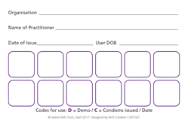
Get It On Card (GIO)
Get It On Condom Card is also known as the C-Card (Condom card)
Get it On (GIO) is the condom distribution scheme running across Hampshire, Isle of Wight, Portsmouth and Southampton.
If you are under 25 you can get free condoms from lots of different organisations. Even if you are under 16 years old you can still join the scheme.
A GIO Condom-Card (C-Card) is a 2-sided wallet sized card that looks like this:
Notes:
More information can be found at https://www.letstalkaboutit.nhs.uk/contraception/get-it-on-condom-card/

Slide 31
How do I get a GIO C-Card?
You will need to visit a GIO C-Card venue where a trained worker will have a confidential chat with you. This will include some personal questions so they can make sure they’re giving you the correct information and advice, and they will teach you how to use a condom.
Once that’s done, you will be given your GIO C-Card and some free condoms.
You can then use your GIO C-Card in any GIO venue.
Notes:
A list of these venues can be found on our website https://www.letstalkaboutit.nhs.uk/contraception/get-it-on-condom-card/
If video doesn’t load (you tube) it can also be found here: http://www.letstalkaboutit.nhs.uk/yp

Slide 32
Video
What happens in a clinic video 3mins
Notes:
This short video gives a visual guide with written talk-through on what to expect when attending a clinic. The clinic used in the video is Crown Heights in Basingstoke, but gives a good representation of what you would expect to experience at any of the locations. Please don’t this video pre-dates COVID and any changes in procedures due to COVID guidance.
If the link isn’t working please visit: https://www.letstalkaboutit.nhs.uk/other-services/support-for-young-people/young-persons-advice-guide/ to access the video (we will be changing the video in due course and the current version will be uploaded on this page)

Slide 33
Summary
You need to have/give enthusiastic consent to have sex
Sexual Health Services are free and confidential
You can access STI screening and contraception from our clinics
Not all STI’s have symptoms so screening is essential
Condoms are the only contraception that will protect against STI’s – available free from GIO condom sites and clinics
You can access Emergency Contraception from the Pharmacies, GPs and Sexual Health Clinics

Slide 34
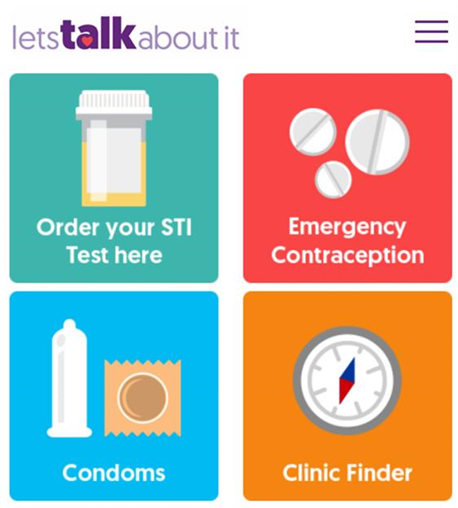
Our Website provides lots of helpful Information and Advice
Young Persons Sexual Health Advice Guide at www.letstalkaboutit.nhs.uk/yp
Website Home page
www.letstalkaboutit.nhs.uk

Slide 35
Further Support
If you would like to talk to someone confidentially, you can contact a local practitioner by email to:
snhs.sexualhealthpromotion@nhs.net
Find us at:
Instagram: @letstalkhants
Facebook: @letstalkhampshire
Online services are available for anyone aged 15 years and over:
Chlamydia test kit (15-24)
Condoms by Post (16+)

