Slide 1
Community Pharmacy Contraception Services Refresher Event
September 2023
Hampshire, Isle of Wight, Portsmouth & Southampton

Slide 3
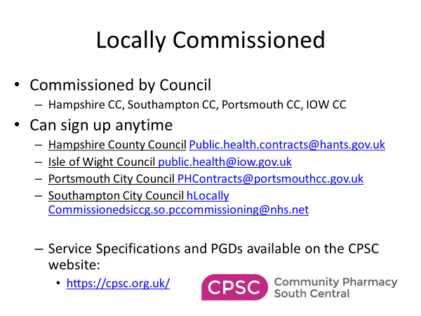
Notes:
Hampshire and Isle of Wight Councils use the same spec and PGDs
We are hoping to get all aligned to make it easier for pharmacists working across LA boundaries
Please encourage locums to complete the required training to enable them to provide the service.
Government consultation currently live to allow registered techs to operate against a PDG. So at some time next year/ 2025 who knows.
Consultation open for responses until Friday 29th September

Slide 7
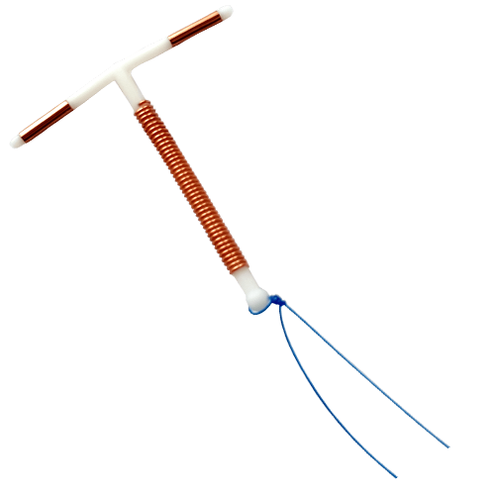
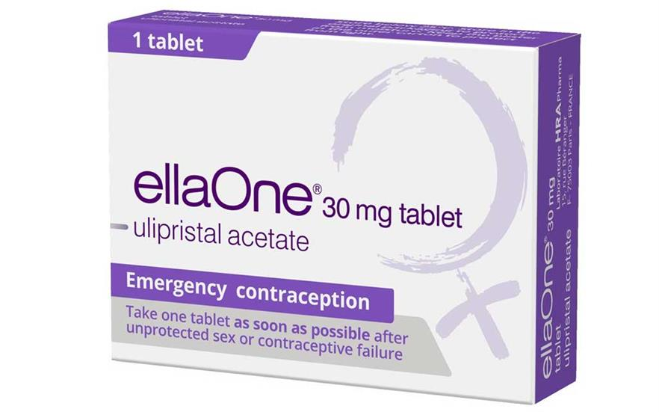
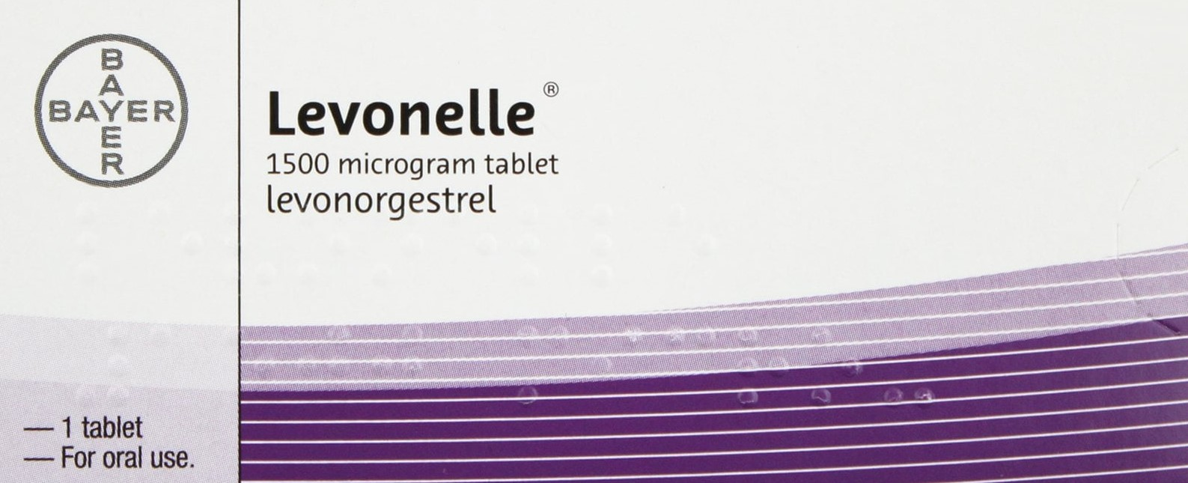
Emergency Contraception – An Update
Means of preventing pregnancy following unprotected sex (UPSI) or contraceptive failure
Levenorgestrel LNG (Levonelle®,Isteranda®,Upostelle ®) Ulipristal acetate UPA (EllaOne®)
Copper IUD Cu IUD

Slide 8
What needs to be covered

Slide 10
How do they work?
Both Levenorgestrel LNG and Ulipristal acetate UPA – inhibit or delay ovulation for 5–7 days, by which time any sperm in the reproductive tract will have become non-viable.
Ulipristal acetate UPA is able to work to suppress the LH surge so is better when given closer to ovulation than LNG
Neither have any effect once ovulation has occurred
Copper IUD – copper is toxic to sperm and ova giving immediate effect to prevent fertilisation. Secondary effect prevents implantation.

Slide 11
Which One?
Cu IUD is the most effective method 10 x more effective than EHC – can be used up to 5 days after UPSI or 5 days after earliest calculated date of ovulation
Evidence shows that the effectiveness of UPA is maintained up to 120* hours after unprotected intercourse or contraceptive failure.
Evidence shows that giving LNG up to 72hrs* and 96** hrs after UPSI was not significantly different from that on day 1 BUT on day 5 (120 hours) it was a similar pregnancy rate to not giving it at all. **Unlicensed use *Licensed use
Notes:
Meta analysis of 4 WHO RCT’s 2011 looking at the effect of the delay in administration of LNG for EC on pregnancy rates.

Slide 12
Case Scenario
It is Monday morning - Maya calls into the pharmacy asking for advice having missed 2 of her pills at the weekend because she went away to see her boyfriend. They had sex without using a condom on Friday, Saturday and Sunday.

Slide 13
What do you need to know?
Which pill?
POP Cerelle (desogesterel)
Has it been taken correctly up until now?
Yes
Does she need EC?
Yes, UPSI in the last 72 hours AFTER missing her pills
What can/should you offer her?
IUCD (most effective) or Levenorgestrel LNG BUT NOT UPA (EllaOne) because has been using a progesterone in the previous 7 days.
What else do you need to know?
Any drug interactions, weight (double dose if BMI > 26 or weight > 70kg)
Is there an IUCD appointment you can refer her to in the next 2 days

Slide 14
Is the person taking medication that may interact with EHC?
Hormonal contraception - UPA (a progesterone receptor modulator) effectiveness is reduced by use of progesterone in the 5 days after taking and theoretically could be affected by its use in the preceding week. LNG or Cu IUD could be offered.
Liver enzyme-inducing drugs e.g St John’s Wort, rifampicin and carbamazepine. Current use or use within last 28 days
IUD is the preferred option.
LNG double dose – unlicensed use but support by FRSH
UPA is not advised
Drugs that increase gastric pH such as antacids, proton pump inhibitors (e.g. lansoprazole, omeprazole, esomeprazole and cimetidine), may reduce the plasma concentration of UPA and decrease its efficacy. Avoid concomitant use.

Slide 15
WEIGHT
FSRH guidance states -
The effectiveness of LNG-EC could be reduced if the BMI >26 kg/m² or weight >70 kg.
It is recommended that either UPA-EC or a double dose (3 mg) of LNG-EC is given in this situation. It is unknown which is more effective.
Notes:
A previous European review concluded that emergency contraceptives (levonorgestrel and ulipristal acetate) are suitable for all women regardless of body weight or body mass index [MHRA, 2014].

Slide 16
Case Scenario
It is Monday morning – Uzma comes to the pharmacy for advice. She had a coil fitted at the time of her caesarean section 8 weeks ago and has just had her first period. When she tried to feel her coil threads, she couldn’t find them.

Slide 17
What do you need to know?
What else do you need to know?
She last had sex 4 days ago (and also 2 weeks before that). It is an LNG IUD that she had fitted and she is breast feeding.
Does she need EC?
Yes, UPSI in the last 120 hours if you assume the coil may have expelled
What can/should you offer her?
NOT an IUCD as unknown risk of pregnancy. Levenorgestrel LNG BUT NOT UPA (EllaOne) because could have been using a progesterone in the previous 7 days AND breast feeding.
What else do you need to do?
Any drug interactions, weight (double dose if BMI > 26 kg/m² or weight > 70kg)
Advise her that it is important to use condoms until she can see her GP to have an USS arranged to check for the coil.

Slide 18
Breastfeeding or post partum?
A copper IUD can be used for E/C from 4 weeks or more postpartum but NOT between 48 hours to less than 4 weeks postpartum (whether breastfeeding or not).
LNG can be used during breastfeeding, although a small amount is excreted in breast milk - advise to take LNG immediately after breastfeeding.
The manufacturer of UPA advise avoid breastfeeding for 1 week after taking.

Slide 19
Case Scenario
It is Tuesday afternoon – Nemy comes into the pharmacy to ask for “the morning after pill”
On questioning you establish that they had sex Thursday night but no other episodes in the last week.

Slide 20
What do you need to know?
Are they using any other method of contraception or have they used any EC since their last period?
No
Do they need EC?
Yes, UPSI in the last 120 hours
What can/should you offer?
IUCD (most effective) or UPA (EllaOne). LNG is unlikely to be effective and is outside of any licenced use / recommendations
What else do you need to know?
Any drug interactions, breast feeding, medical conditions

Slide 21
Is there any past medical history?
Severe asthma insufficiently controlled by oral corticosteroids - UPA has a high affinity for glucocorticoid receptors: consider LNG or Cu IUD.
Severe malabsorption syndromes such as Crohn's disease or gastric bypass surgery, may impair the efficacy of hormonal EC: consider a Cu IUD.
Fibroids or current pelvic inflammatory disease – IUD’s are not recommended if there is active pelvic infection or a distorted endometrial cavity: consider LNG or UPA.
Severe hepatic dysfunction affects the metabolism of UPA and LNG: consider a Cu IUD.

Slide 22
Case Scenario Cont.
Nemy had planned to start the combined pill that the GP had prescribed – what advice do you now need to give?

Slide 23
Quick starting after EC
Starting contraception at the time of the consultation or following EC
Unlicensed use
Can be a “bridging” method or on-going method
POP active with 48 hrs (quickest acting)
PT 3 weeks after starting a method

Slide 24
UPA and Quick starting
Recommendation -
Hormonal contraceptive methods should not be started for at least 5 days and use barrier methods.
After 5 days, start the hormonal method with the usual recommended contraceptive precautions depending on the method used

Slide 25
Repeat use of Emergency Contraception
Taken UPA – EC
LNG – EC should not be taken in the following 5 days
Cu IUD or UPA- EC
Taken LNG – EC
UPA-EC could theoretically be less effective if taken in the following 7 days
Cu IUD or LNG – EC

Slide 26
Side effects
Nausea and Vomiting
Mood disorders
Dizziness
Myalgia and back pain.
Breast tenderness
Pelvic and period type pain
Fatigue
Vomiting occurs in about 1% of people taking hormonal emergency contraception.
Nausea is more common and occurs in about 14% of people.
If a person vomits within 2 hours of taking levonorgestrel or within 3 hours of taking ulipristal acetate, prescribe a second dose of hormonal emergency contraception to be taken as soon possible.
If vomiting is persistent offer the copper intrauterine device (IUD), or an antiemetic.

Slide 27
Follow up
Pregnancy test in 3 weeks, if period more than 7 days late or bleeding lighter than usual.
Most people will have a normal period at the expected time; some will have their period later or earlier than normal
STI screening in 2- 3 weeks - Studies show that 9.1% of women younger than 25 years of age, requesting emergency contraception, tested positive for chlamydia.
Advice regarding on going contraception
Notes:
REPEAT DOSES

Slide 28
Encouraging Better Contraception
“It seems to me that it is quite important for you not be pregnant at the moment, have you thought about starting contraception or using a more effective method after this?”
How important is it for you not to be pregnant at the moment?
Are you planning a pregnancy anytime soon?
How difficult was it for you to find a pharmacist able to provide emergency contraception today?
How often have you forgotten your pill in the last 6 months?
Have you ever had to use emergency contraception before?
Are you unhappy or worried about side effects of your current method?
Would you prefer not to have to think about contraception?

Slide 30
Case Scenario
Emily, 21 year old
Not using any contraception
Last UPSI 6 days ago
LMP 20 days ago
Shortest cycle 31 days
Can you offer her any emergency contraception?
A CuIUD can be inserted for EC -
Within 5 days of FIRST UPSI since LMP, OR
Within 5 days of the earliest calculated date of ovulation, whichever is later
CuIUD is 10 x more effective than oral EC and provides on going contraception

Slide 31
Case Scenario – Method to work out answer
First day of the last menstrual period
Earliest calculated date of ovulation
1 | 2 | 3 | 4 | 5 | 6 | 7 | 8 | 9 | 10 | 11 | 12 | 13 | 14 | 15 | 16 | 17 | 18 | 19 | 20 | 21 | 22 | 23 | 24 | 25 | 26 | 27 | 28 | 29 | 30 | 31 | 32
14 days
Emily, not using any contraception. UPSI 6 days ago, LMP 20 days ago. Shortest cycle 31 days
What emergency contraception can you offer her? Can she have the emergency IUCD?

Slide 32
Summary
CuIUD is about 10 times more effective than any oral EC and provides on going contraception
UPA-EC – first line oral EC if UPSI 5 days prior to estimated day of ovulation
BMI > 26 or weight > 70 kg – double dose of LNG-EC
Quick starting contraception – wait for 5 days after UPA-EC
Pregnancy test in 3 weeks

Slide 33
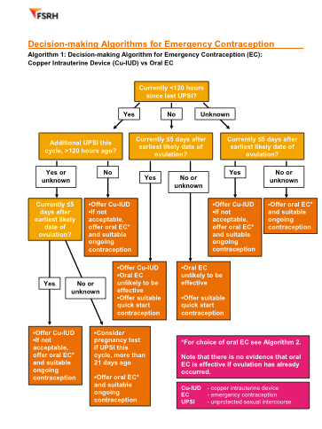
Decision Algorithms fsrh.org.uk standards and guidance – current clinical – emergency contraception

Slide 34
Sexual Health Services Hampshire Isle of Wight Portsmouth Southampton

Slide 35
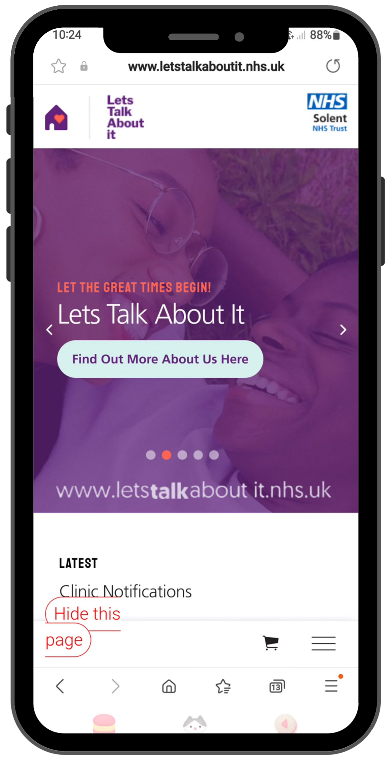
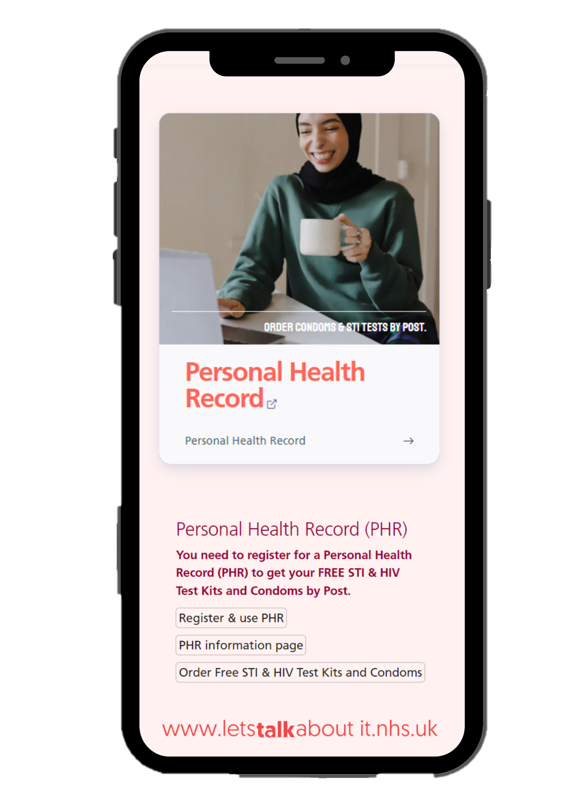
Accessing Our Service
Clinic Finder
Referrals
Specialist Clinics
Information for Professionals
PHR Personal Health record
Online:
Online Testing
Condoms By Post
24/7 ‘Need Help’ Facility
Advice and Information
Support for young people
Main hubs:
St Mary’s Hospital, Portsmouth
Royal South Hants, Southampton
Crown Heights, Basingstoke
Andover Health Centre
Aldershot Centre for Health
St Mary’s Hospital, Isle of Wight
You can find details of the nearest
sexual health clinic at:
www.letstalkaboutit.nhs.uk
-Click the clinic finder button
Or call: 0300 300 2016
Notes:
Change phone

Slide 36
Referrals to Sexual Health Promotion 1:1
Clients who are sexually active or with the indication to be sexually
active soon and with the risk of STIs, or teenage pregnancy.
This includes patients who are:
Having unprotected sex with multiple sexual partners
People living with HIV
Men who have sex with men /Gay/Bisexual/Transitioning/BME
Young people, not using contraception
www.letstalkaboutit.nhs.uk/referrals/sexual-health-promotion-11-support-referral

Slide 37
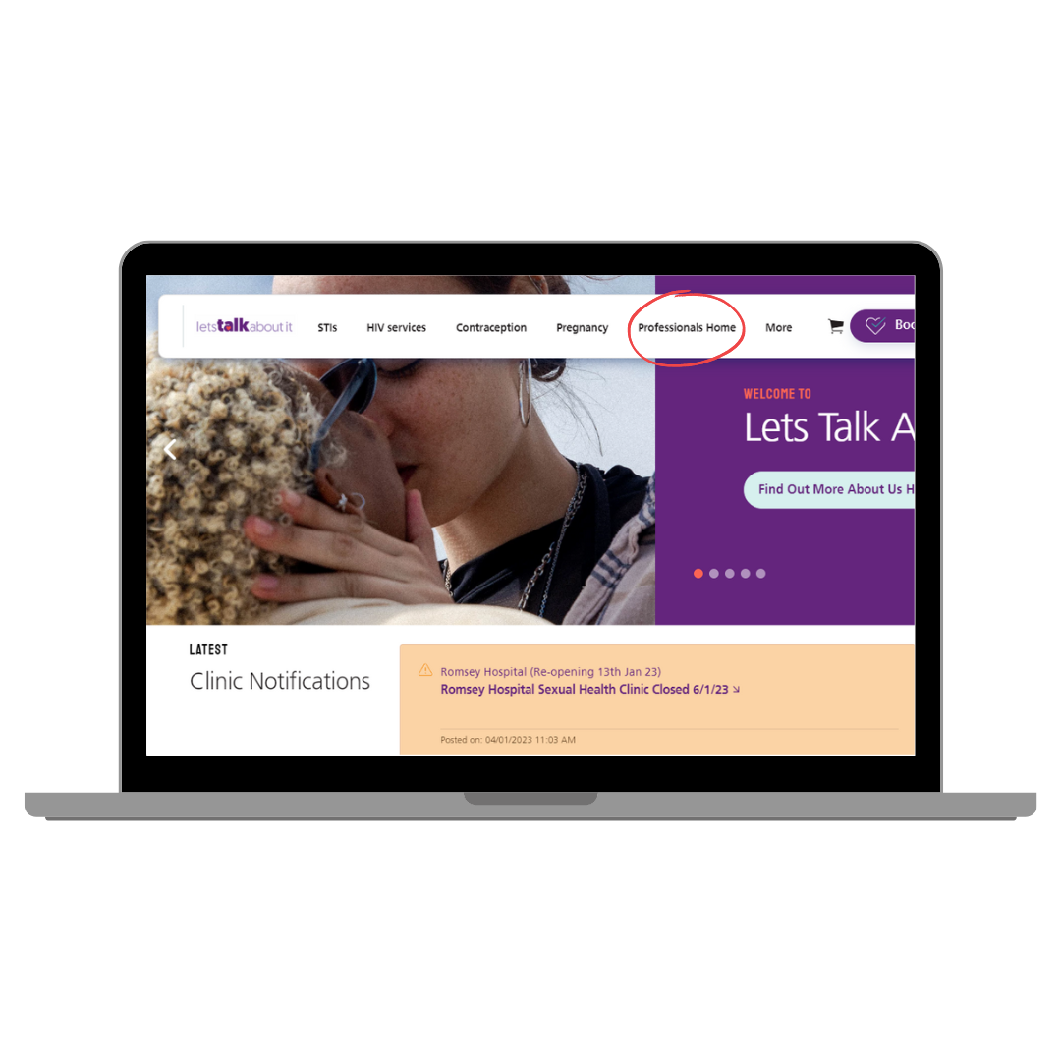
How To Make a Referral
Referral form available at www.letstalkaboutit.nhs.uk/referrals
Complete relevant sections
Send to: Snhs.sexualhealthreferral@nhs.net
If you are unsure if a Sexual Health Promotion Referral is appropriate, please contact the team or your local practitioner. It is always necessary to gain the patients consent prior to a Sexual Health Promotion referral being made.

Slide 38
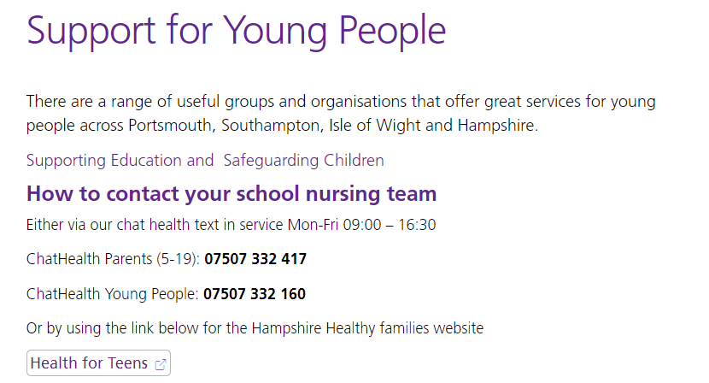
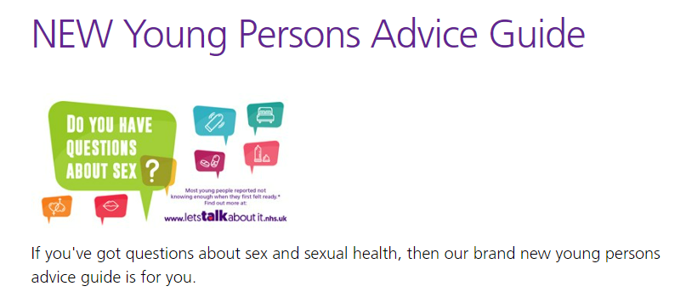
Supporting Young People
We have lots of information written for young people on our website, buttons take individuals to relevant sections on our website. We also have a ‘Young persons Advice Guide’
There is a section on our website for ‘Professionals’ supporting young people:
www.letstalkaboutit.nhs.uk/rse

Slide 39
STIs including HIV
Commonly tested and diagnosed STIs:
Chlamydia (most commonly diagnosed STI in people aged under 25)
Gonorrhoea
HIV
Syphilis
HSV (Herpes)
HPV (Genital Warts)
Hepatitis B and C (for people in higher risk groups)

Slide 40
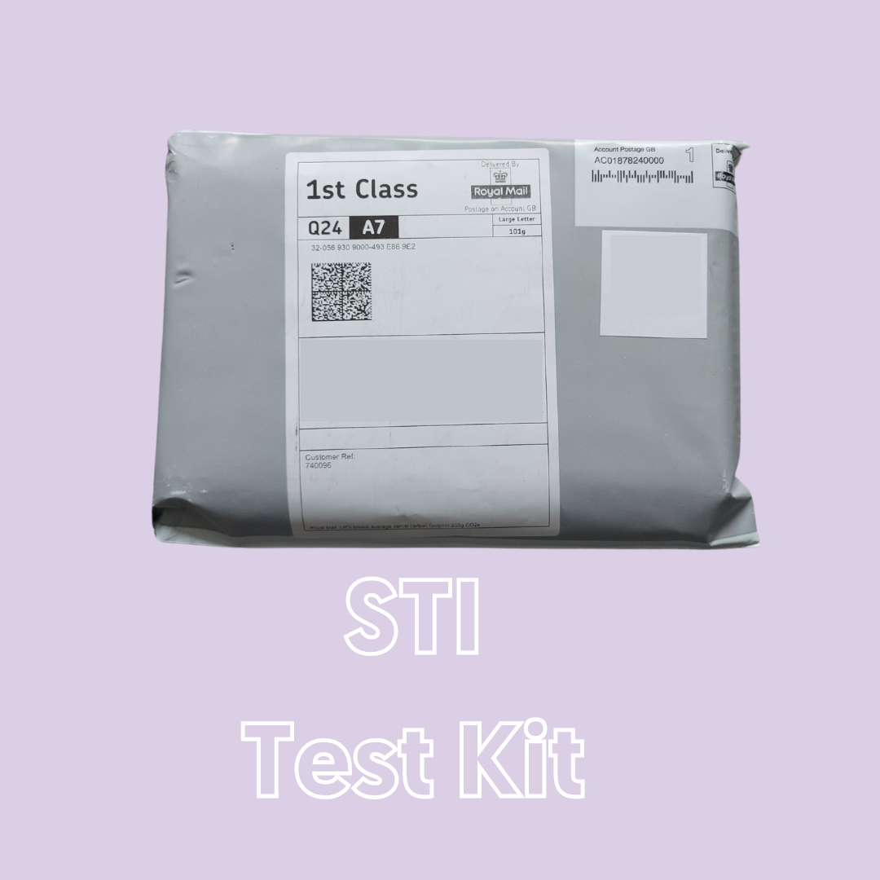
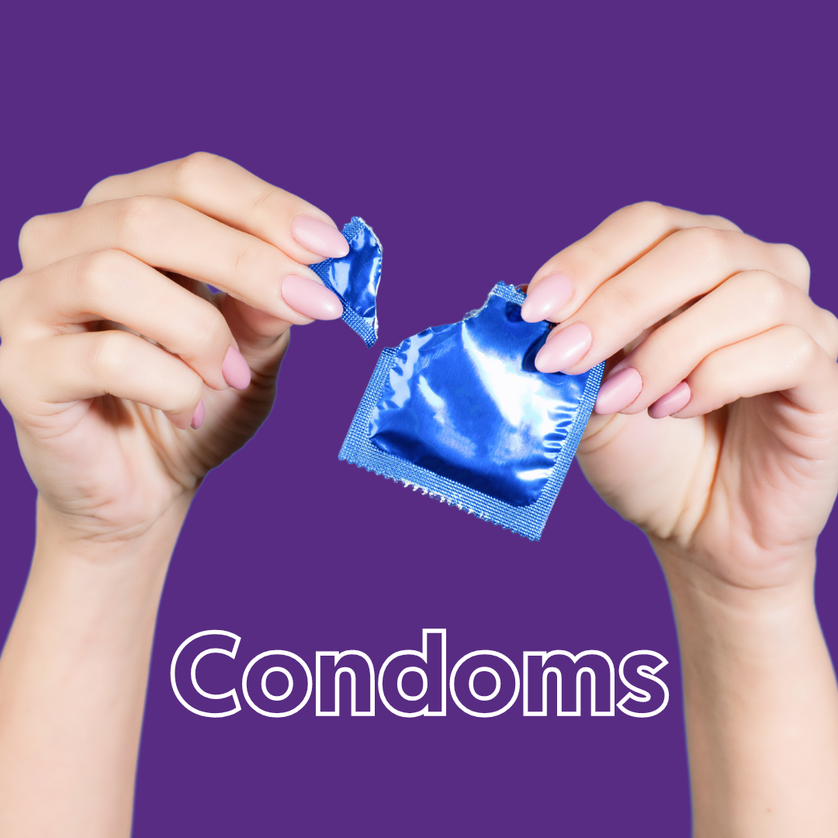
Prevention
Regular Testing
Chlamydia Testing Kit (15- 24)
Young People’s Walk- in Clinics
Full STI Kit (18+)
www.letstalkaboutit.nhs.uk/test
Condoms
GIO Scheme - under 25’s
Condoms by Post- 16+
Sexual Health Clinics
www.letstalkaboutit.nhs.uk/condoms

Slide 41
LARC-Long Acting Reversible Contraception
Fit and Forget
https://www/.letstalkaboutit.nhs.uk/contraception/fit-forget-contraception

Slide 42
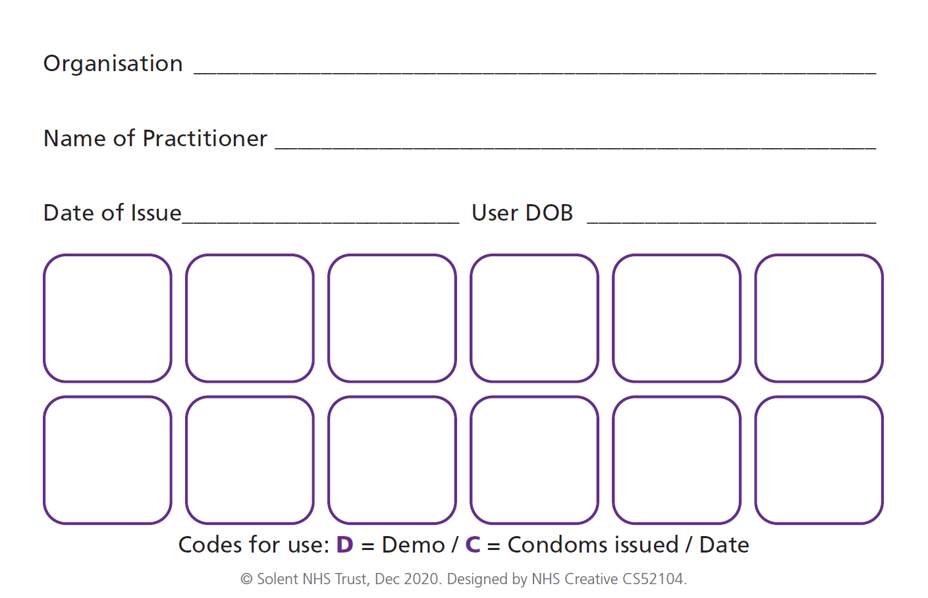
Get It On Card (GIO) Scheme
Get It On Condom Card is also known as the C-Card (Condom card)
Get it On (GIO) is the condom distribution scheme running across Hampshire, Isle of Wight, Portsmouth and Southampton.
Anyone under 25 can get free condoms from lots of different organisations. Even if they are under 16 years old they can still join the scheme.
www.letstalkaboutit.nhs.uk/getiton
www.letstalkaboutit.nhs.uk/gio (Professionals Page)
A GIO Condom-Card (C-Card) is a 2-sided wallet sized card that looks like this:
Notes:
More information can be found at https://www.letstalkaboutit.nhs.uk/contraception/get-it-on-condom-card/

Slide 43
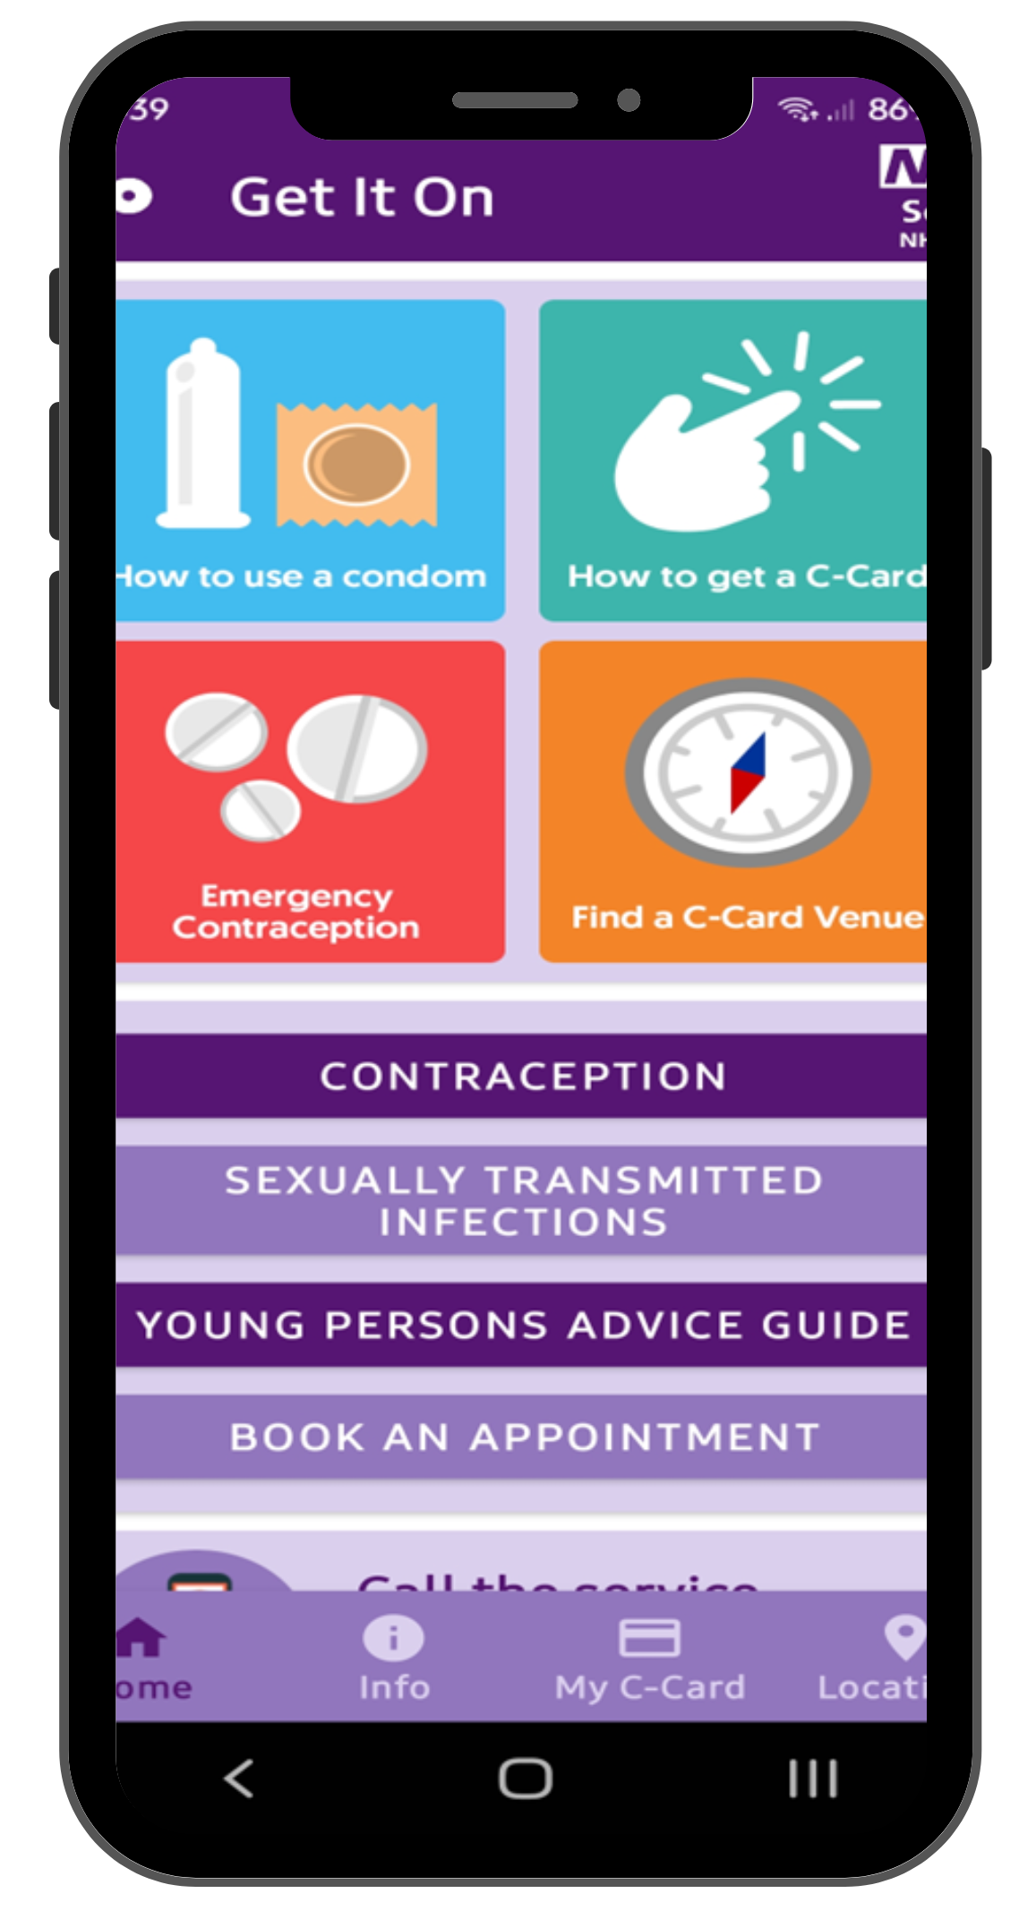
Coming Soon C Card App
The existing physical cards will remain an option for young people and the current arrangements for that will remain the same. This app provides young people with an option to carry a digital C-Card and easy access to sexual health information and support.
Training
If you want to sign up to be a venue for the Digital GIO C-Card, there will be a training guide sent out to you. This training should take approximately 15 mins to complete and can be retaken at any point.

Slide 44
If you need more information about services, support or training, please contact the team:
solentsexualhealthpromotion@solent.nhs.uk
SNHS.sexualhealthpromotion@nhs.net (Patient Identifiable Information)

